Slide 1
Remote
Where are you?
What is your relationship?
Why are you here?
Who are you?
Age?
Gender?
Backstory?
When does this take place?

Slide 2
Script Analysis

Slide 3
Given Circumstances
Time: when does it take place?
Place: where is it happening?
Backstory: what happened before the play began?
Mood: how does it make you feel?
World of the Play: the reality inside the play
Society: the ways people live in relation to each other
Economics
Politics
Spirituality (Religion)
Education
Race
Class
Gender

Slide 4
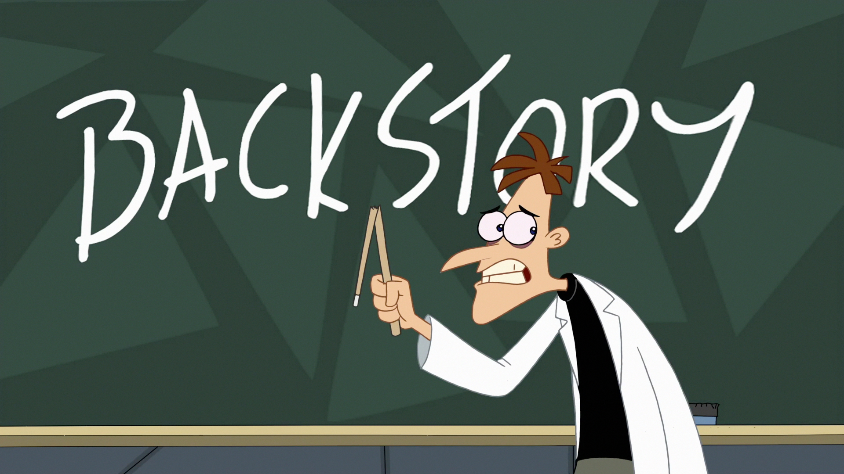
Story
Background Story
What happens outside the play?
What happens onstage?

Slide 5
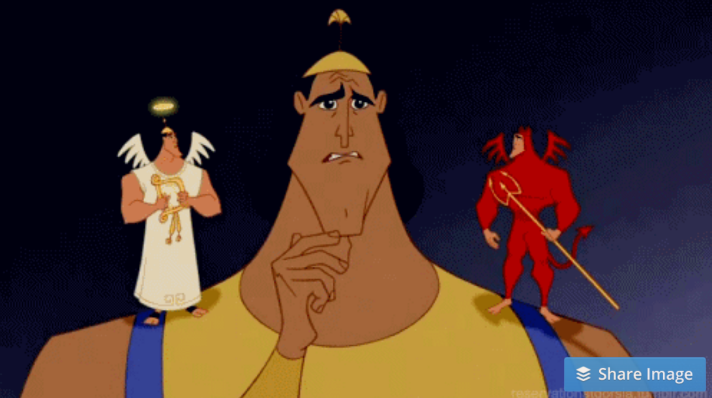
Conflict
External
Internal

Slide 6
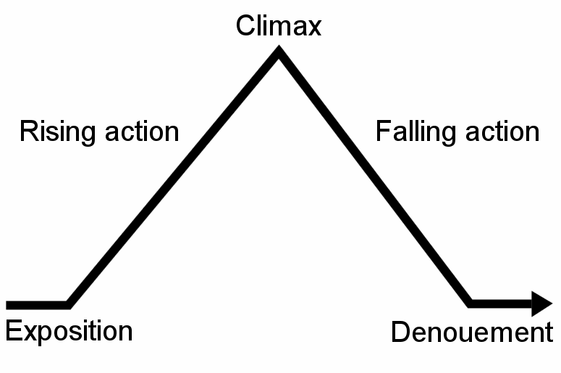
Conflict
Protagonist
Opposing Forces
Climax
Major Dramatic Question
Introductory Incident

Slide 7
Characters
Who are they?
Gender
Age
Backstory
What is their relationship?
How do they respond to given circumstances?
What does the dialogue tell us?
What do the stage directions tell us?
Apply Acting Lessons

Slide 8
Character Map

Slide 9
Idea
What are the main ideas and themes?
In the Words?
In the Characters?
In the Plot?
What is the central message?
How do you know?

Slide 10
Interconnectedness
How does the story connect to your life?
How does the script connect with other theatre?
Different kinds of art?

Slide 11
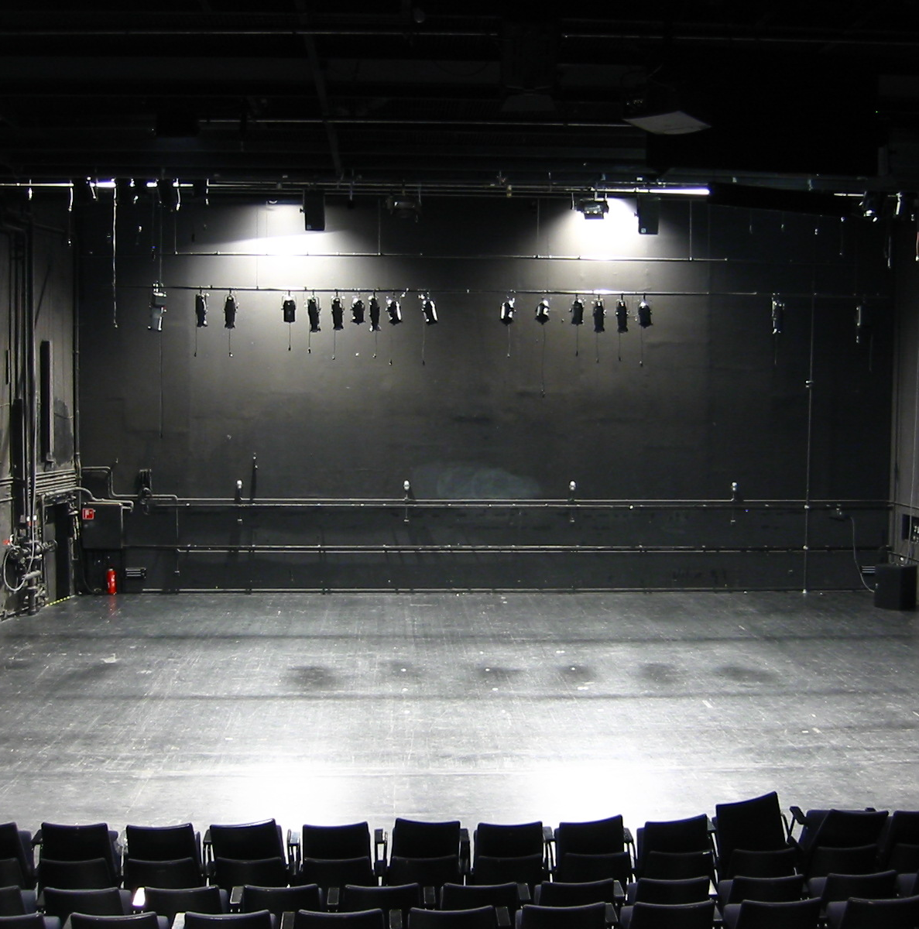
Representation
How would you portray this on stage?
Design: set, costumes, lighting, casting, sound makeup, etc.
Acting style?
What do you need to do so your audience will understand?

Slide 12
Homework!
Read this short play.
Bring your script with you on Thursday so we can keep working on it

