Slide 1
Becoming Beautiful Historically

Slide 2
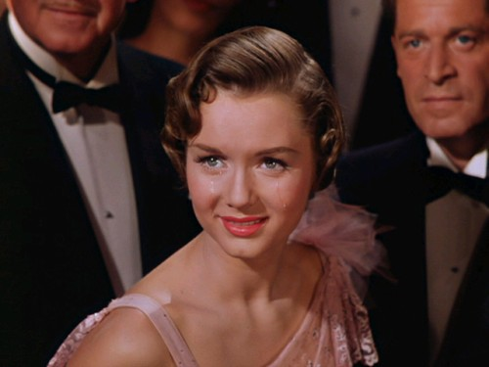
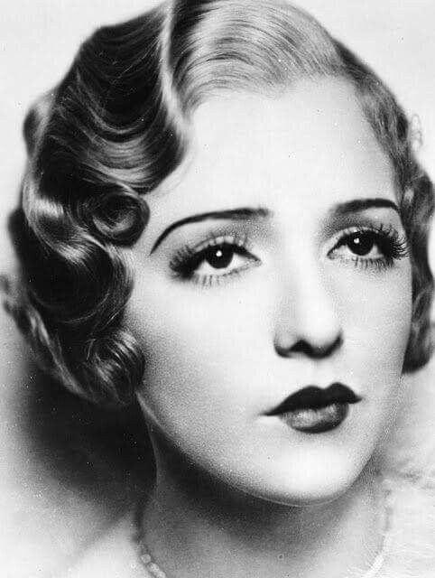
1920’s

Slide 3
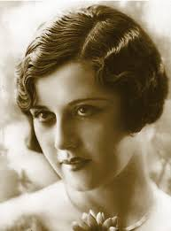
Trends
HAIR
Hair was usually short and styled in a bob that was tight to the head. Fingerwaves were very popular.
MAKEUP
Makeup typically showed pale skin with bold lipstick. They had thin eyebrows, and dark eyeshadow.

Slide 4
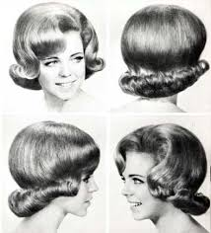
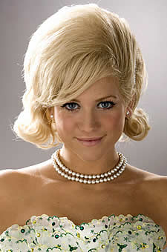
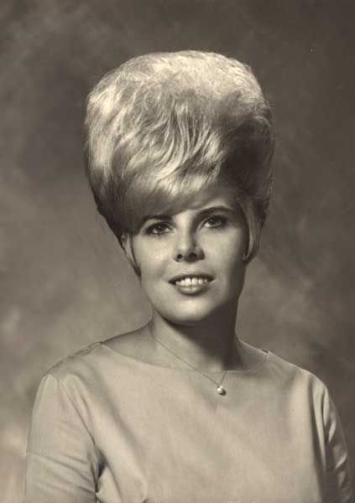
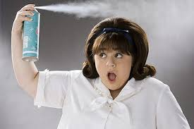
1960’s

Slide 5
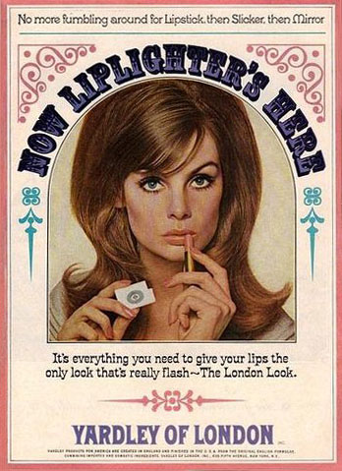
Trends
MAKEUP
Makeup started to reflect pastel colors, especially in the lipstick. Eyeliner also became popular.
HAIR
Hair became big, straight, and tall. There usually wasn’t a lot of curl. Instead, there was a round tower above a woman’s head.

Slide 6
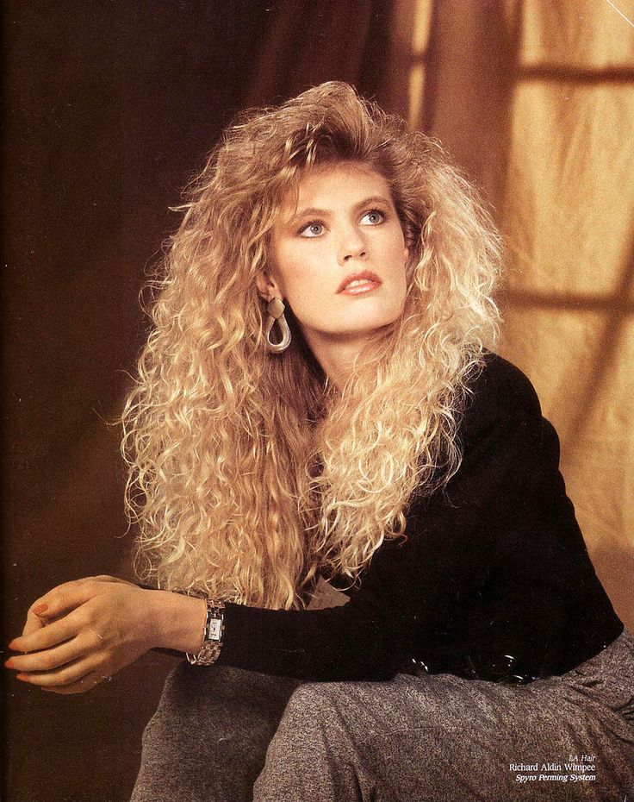
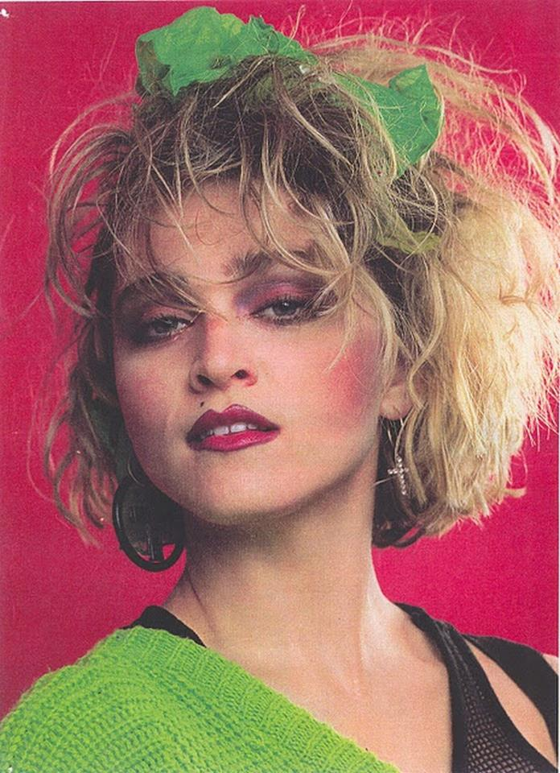
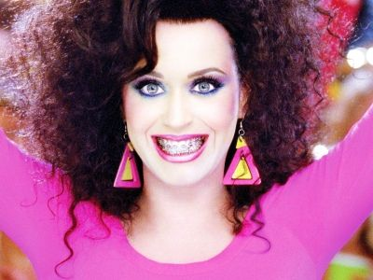
1980’s

Slide 7
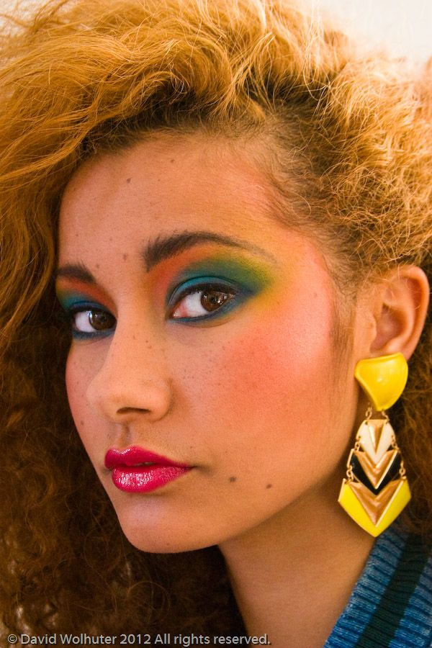
Trends
MAKEUP
The 80’s are when bright colors became the style. The brighter and more obnoxious the color, the better. Colored eyeliner became popular as well.
HAIR
If the hair was massive and curly, then it fit in perfectly.

Slide 8
Footloose
Little Shop of Horrors
Dear Evan Hansen
Grease
Oklahoma!
Dreamgirls
Anything Goes
Mamma Mia
The Music Man

