Slide 1
Bertolt Brecht
Epic Theatre

Slide 2
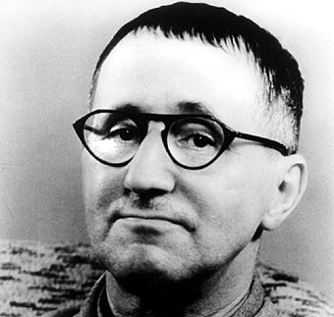
Life and Times
1898-1956
German poet, playwright, and theatre director
Staunch Marxist

Slide 3
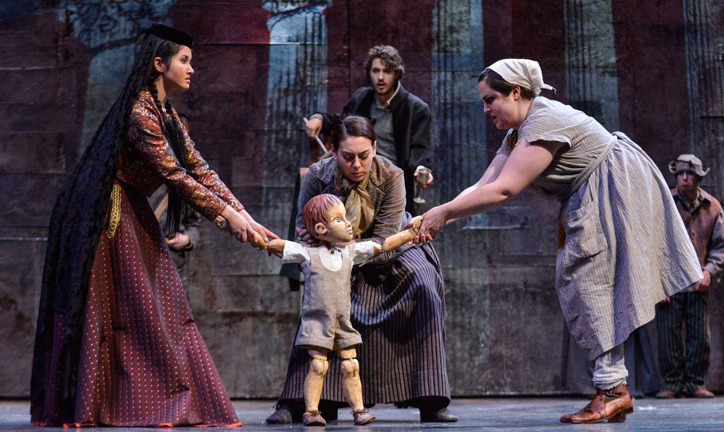
Plays
The Threepenny Opera
Mother Courage and Her Children
The Life of Galileo
The Good Woman of Setzuan
The Caucasion Chaulk Circle

Slide 4
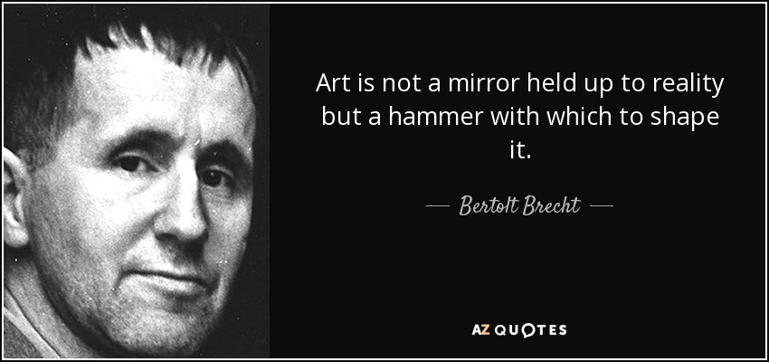

Slide 5
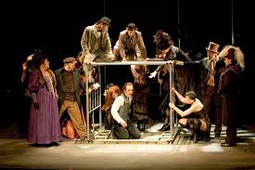
Theory
Loathed the theatre of realism- liked realistic theatre to the effects of a drug, since it pacifies its audience.
Brechtian theatre focused on social issues, usually class issues (Marxism).
Wanted spectators to leave a play and take to the streets rather than leave the theatre in tears.
Used non realistic techniques to distance the audience.

Slide 6
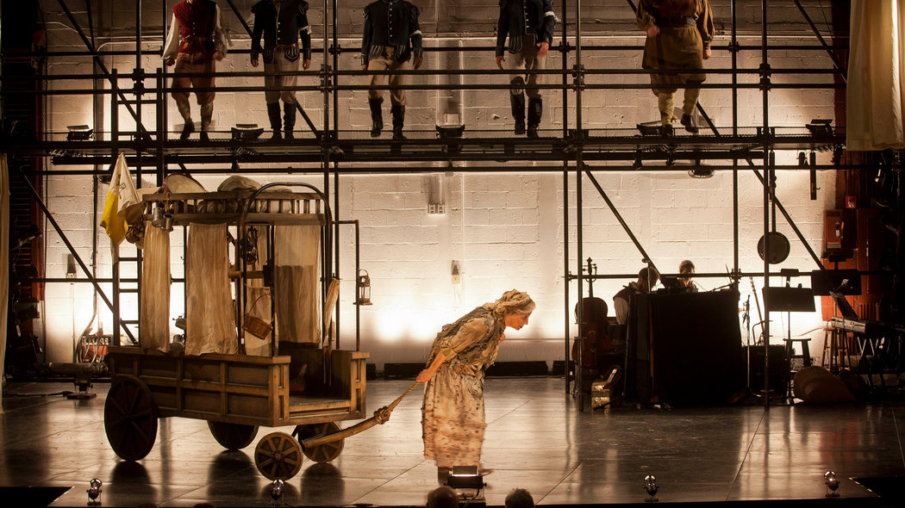
Practice
Verfremdunseffekt (V-effect)- To make the familiar, strange
Mix of realistic and non-realistic movement
Gestus to reveal social class relationships
Direct address to the audience
Revealing the apparatus
“Stock Character” costumes denoting social station
Use of Placards
Masks (non-realistic)
Actor never fully becomes character, detachment

