Slide 1
1
Make sure every person in your group knows the character(s) they are playing.
List on your paper who is playing which parts.
Walk through the outline you created yesterday and confirm that the actor/character assignments work out within the story.
If needed, make adjustments.

Slide 2
2
What is your Theme?
What is your concept?
Why did you choose the concept you did?
Talk through your outline and make sure every plot point works within your chosen concept.
Discuss what might need to be changed in the plotline of your story in order to help the story fit better within the concept.
If there is still time, start running through your story on your feet and make sure the concept works in practice.

Slide 3
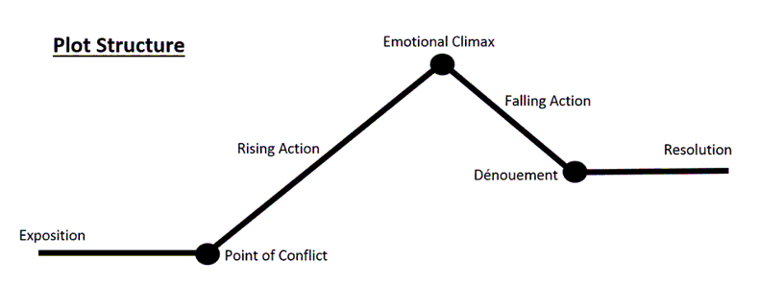
3
Exposition: Also known as the introduction, this introduces the characters, their relationships, the setting, and any previous information needed for the story.
Point of Conflict: The point at which the main problem of the story begins or is introduced.
Rising Action: The exciting bits that build up to the climax. (For this choose one main part of the rising action)
Emotional Climax: The highest or most intense part of the story.
Falling Action: The less exciting bits that lead to the end. (For this choose one main part of the falling action)
Denouement: The part where everything is wrapping up. (again, choose one main point)
Resolution: How the story ends and all the complex bits get resolved.
Using the definitions above, fill in each part of your groups story on your worksheet that correlates with each spot on the diagram.
Confirm that the story makes sense according to the plot structure diagram given. Make any changes if the story doesn’t flow.
Once completed, run through each of those seven points in your story on your feet.

Slide 4
4
Run through your outline on your feet and time it. (You may use a phone to do so.) Write down your time on the worksheet.
If your performance is less than 7 minutes you need to add time. If it’s more than 9 minutes (at this point in the rehearsal process) you may need to cut some time. (Make sure you circle which you need to do on the worksheet.
In a group create a plan for what you will change in order to fix the time. List at least three parts of the story you will work on or edit out.
If you are more than 7 minutes but less than 9, congratulations! Write down three parts of the story you are going to focus on that you think need more work at this point in order to keep the time the same for each run.

Slide 5
5
Discuss the following as a group:
Are we going to use different voices than our own to portray the characters?
Are we going to move differently depending on the character we are playing?
Start running through your story and play around with how you are going to move your body and how you are going to use your voice. (If you don’t get through the entire thing that’s okay, this is just so you can start to experiment.)

