Slide 1
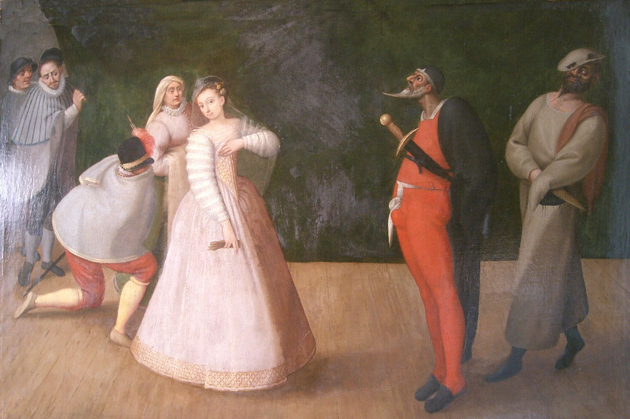

Slide 2


Slide 3
Spanish
Golden Age

