Slide 2
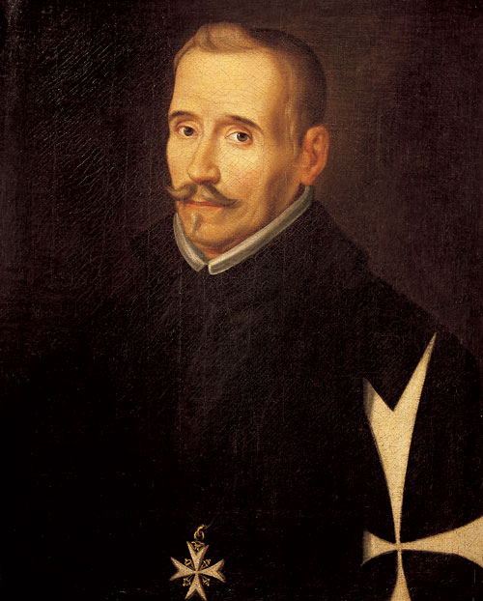

Slide 3
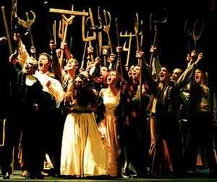
Fuente Ovejuna (The Sheep’s Well)

