Slide 1
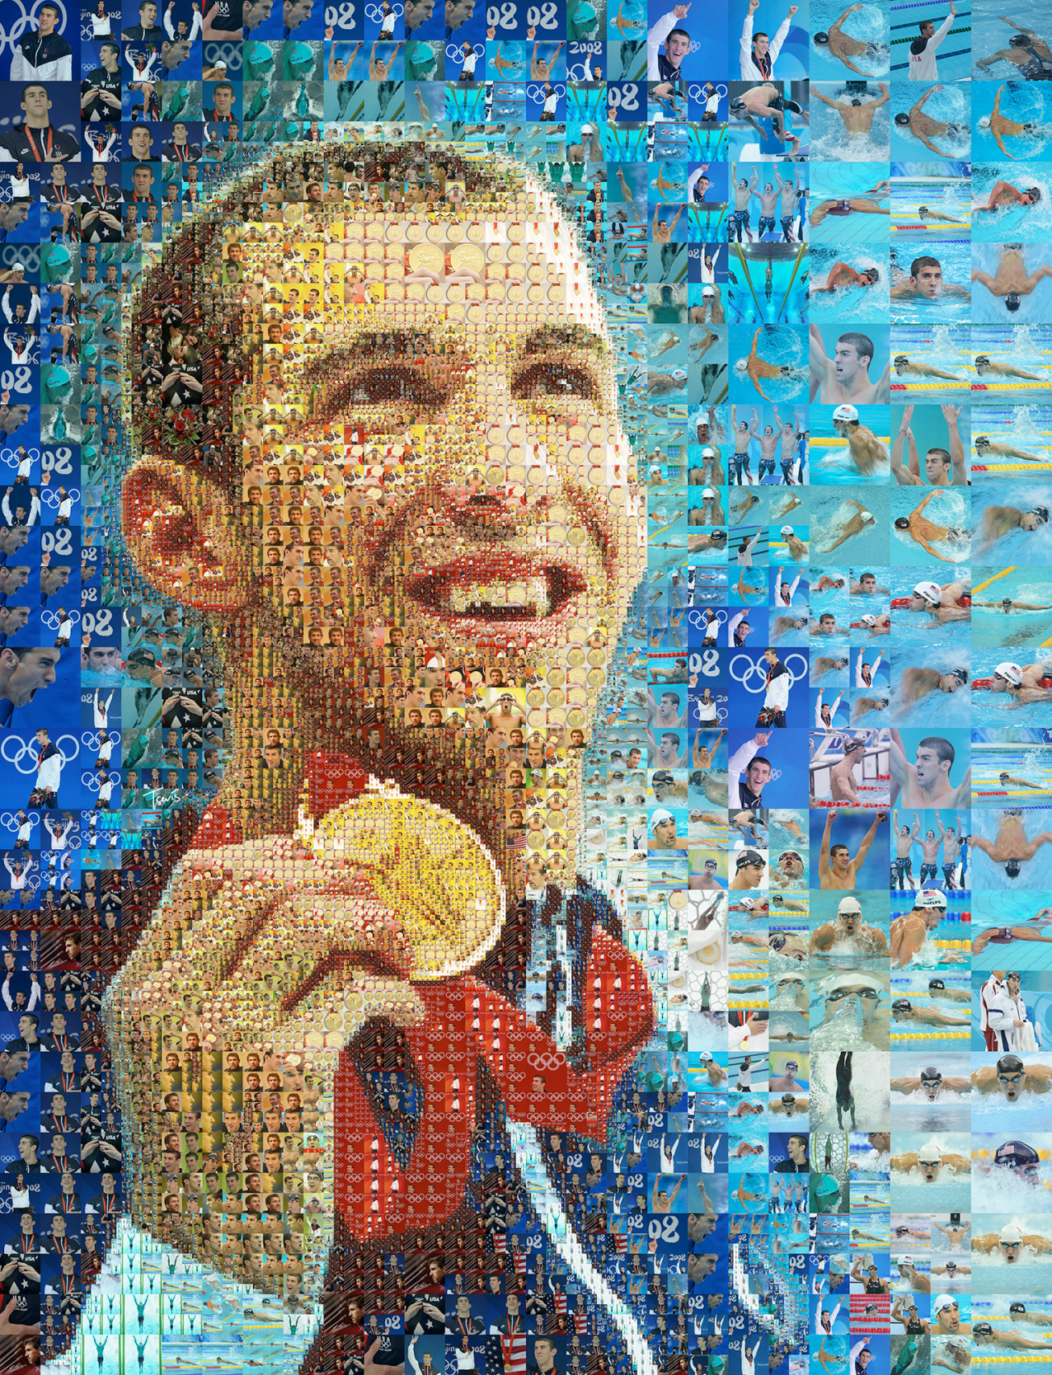
none of us are only ever one story

