Slide 1
What is ART?
What Defines ART for you?

Slide 2
the process of making art
Building blocks of which things are built:
Nature - (who we are) Darwin –we realize now that there are so many little components
Culture - (how we live) Marx - It is a reality but its not an inevitability
The Mind - (who we are how we live) Freud – subjectivity is a real key

Slide 3
Is Film a form of ART?
When? How?

Slide 4
What is the Purpose of Film?

Slide 5
What films move you?

Slide 6
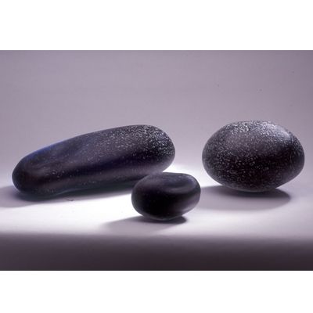
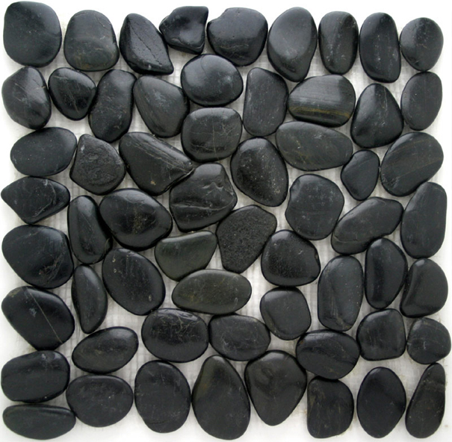
Fragmentation vs. Mosaic
“Which reality is the true reality?”

Slide 7
This is life. These seemingly nonsensical things are what make it all up. Each experience that we go through and every situation we encounter throughout our days make up these little tiles. The little tiles that make up the mosaic of our lives.

Slide 8
Why we fragment out lives…
We fragment our lives because not every single experience and occurrence can be tiled and placed in perfect order. Our tiles make sense the colors, and patterns, all placed accordingly, but it is to the individual that it fits because that is they way they placed it. If another person were to come up and look at my tiles that were making up my mosaic they most likely will not be able to recognize or define a lot of meaning from it. To them my tiles would seem fragmented and irrational. Yet an overriding significance and meaning is easier to find if they took a look at the overall mosaic instead of just my individual tiles.

Slide 9
As we talk further about fragmentation in this montage of tiles, we realize that we can take different perspectives on the mosaic…
At times we have “tunnel vision” where we are stepped in closer and holding our hands up to the sides of our eyes as blinders. This means that we can only see part of the tableau, only a small portion to judge off of.

