Slide 1
Little Red Riding Hood
3 different Viz-es

Slide 2
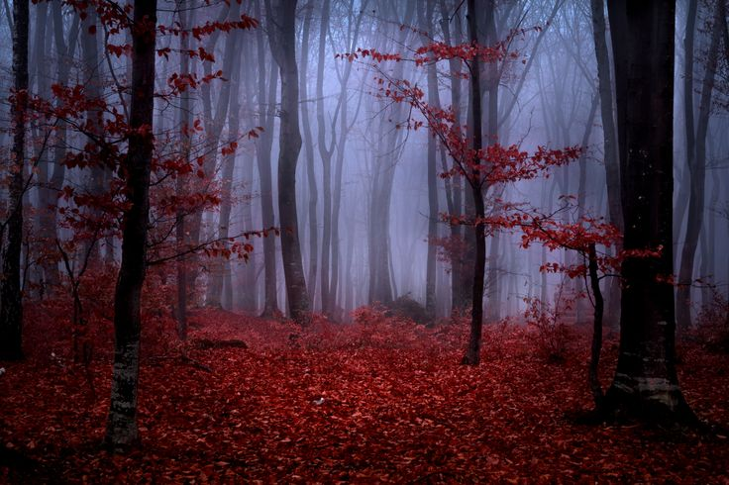

Slide 3
