Slide 1
COLOR
Notes:
One of the most noticeable design elements and is probably the most dominant. Often least understood. Ironic because we grow up with color all around us. All day, every day. Because we are in constant contact with color, lots of time we just accept it without thinking about it. Today going to unpack some of the meanings of color and how we can use it to tell the stories we want to, to manipulate the audience to experience what we want them to.
Grab your notes.
We all have images or emotions that we associate with certain colors. So For the next couple minutes (3-4), going to have you go through each of the colors I write on the board write down what you imagine—what emotions, moods, images, actions, characters do you visualize? Why?

Slide 2
For each color, list emotions, moods, images, or ideas that you envision when you think of it.
RED
YELLOW
BLUE
BLACK
BROWN
ORANGE
GREEN
VIOLET
WHITE

Slide 3
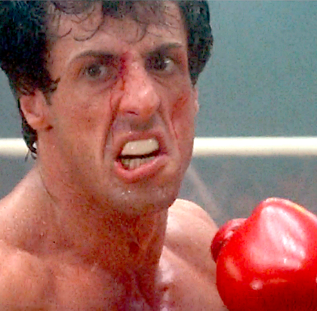
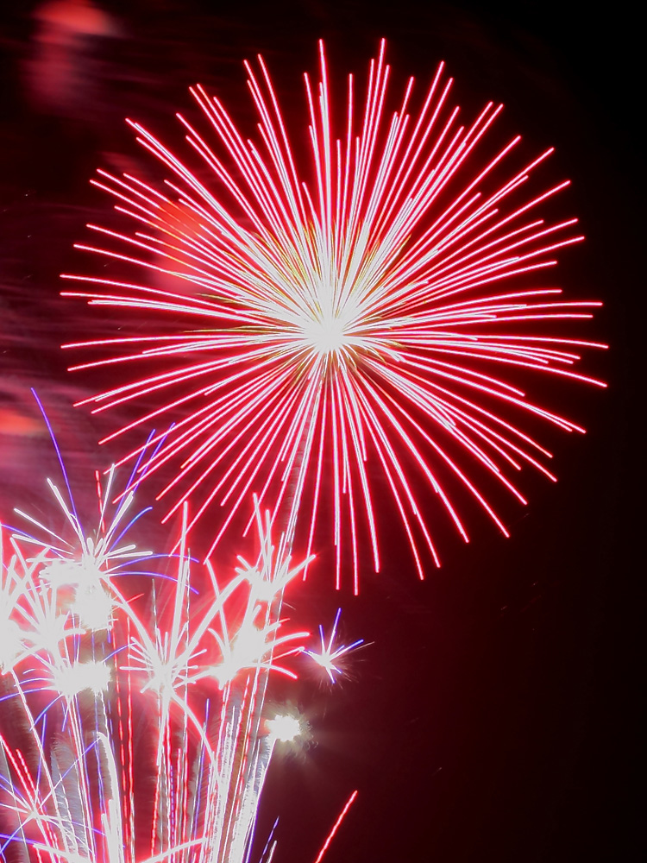
RED
Happy
Affectionate
Loving
Exciting
Striking
Active
Intense
Powerful
Masterful
Strong
Defiant
Aggressive
Hostile
Notes:
What emotions, personalities, character types, images

Slide 4
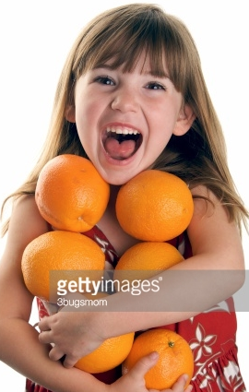
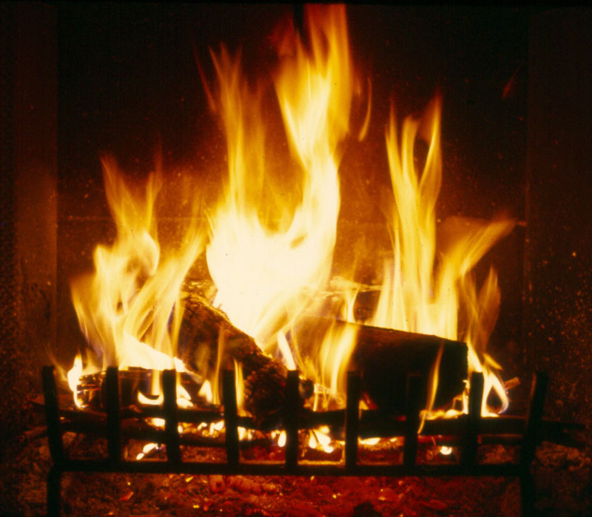
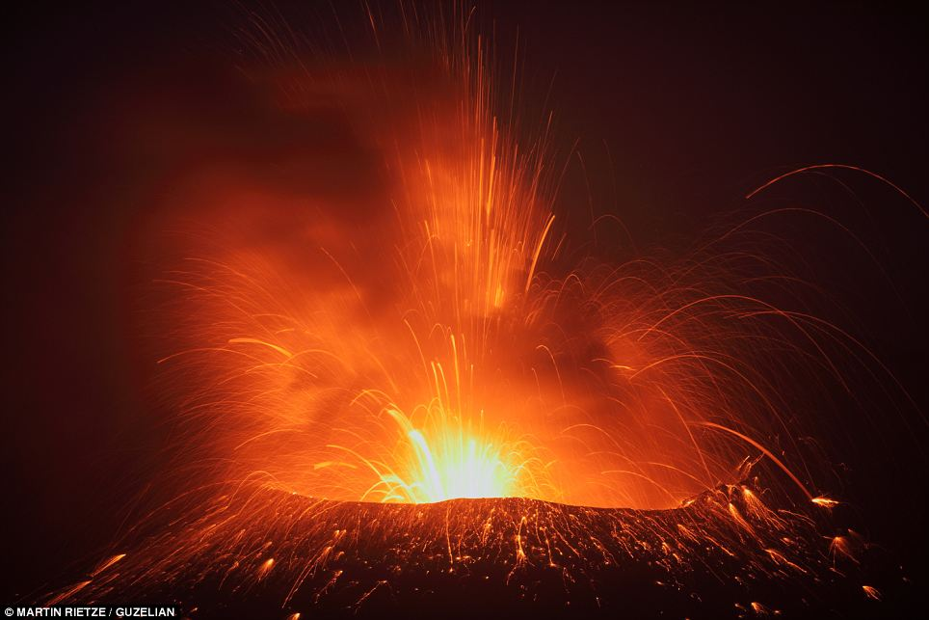
Orange
Warm
Happy
Merry
Exciting,
Stimulating
Hot
Disturbed
Distressed
Unpleasant

Slide 5
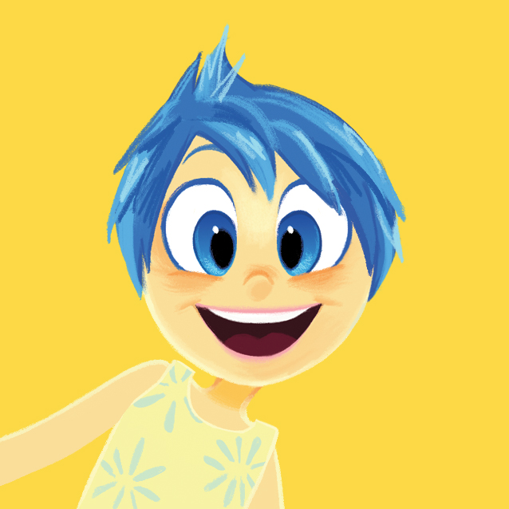
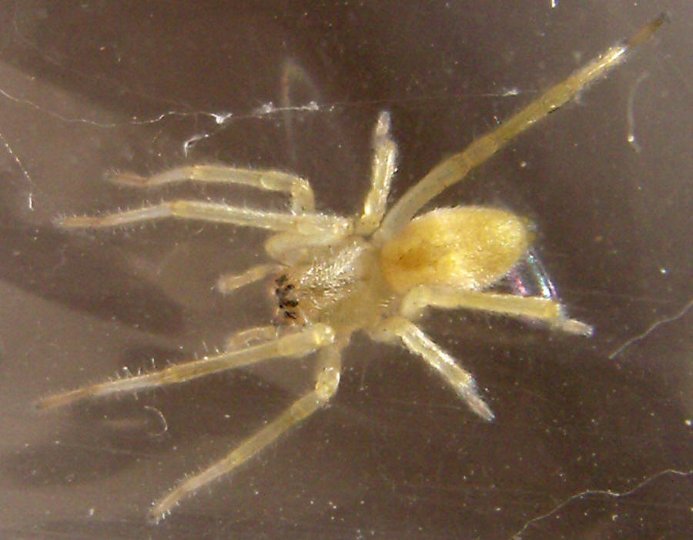
Yellow
Stimulating
Cheerful
Exciting
Joyful
Serene
Unpleasant
Aggressive
Hostile

Slide 6
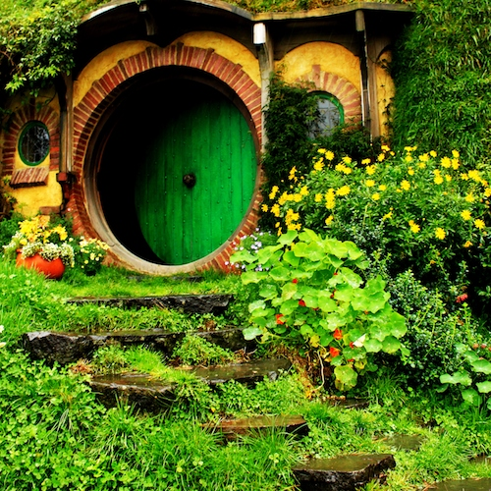
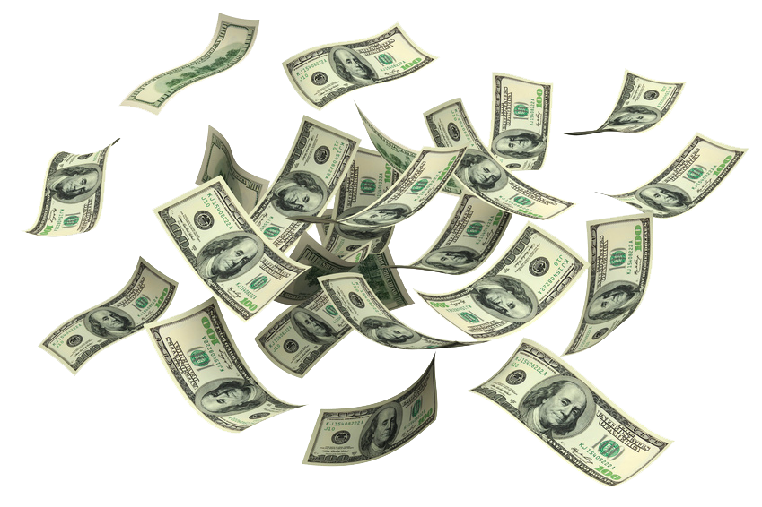
Green
Youthful
Fresh
Leisurely
Secure
Calm
Peaceful
Emotionally Controlled
Ill
Wealthy
Envious

Slide 7
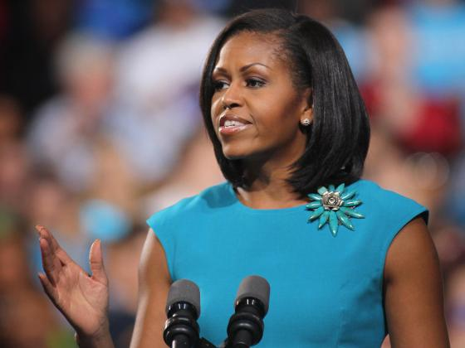
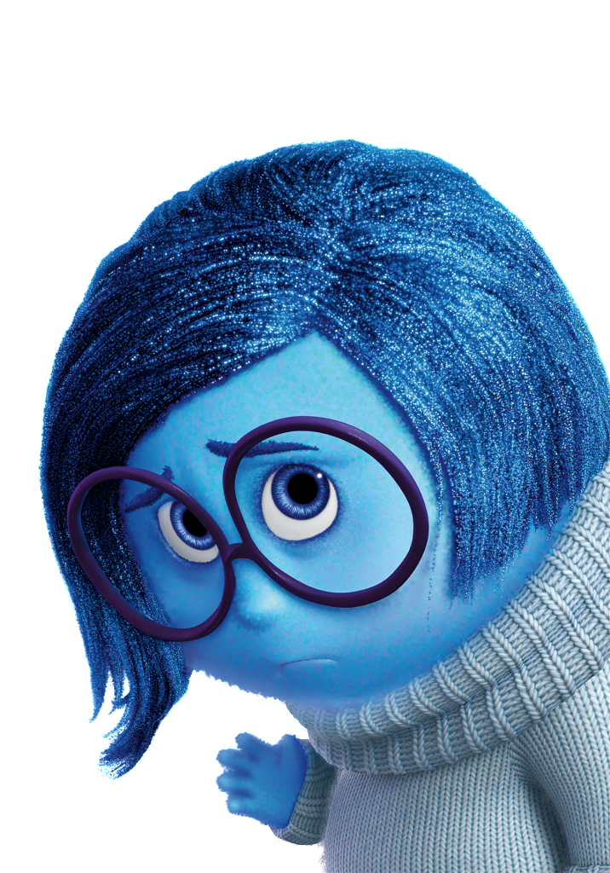
Blue
Pleasant
Cool
Secure
Comfortable
Tender
Soothing
Intelligent
Social
Dignified
Full
Great
Strong
Sad

Slide 8
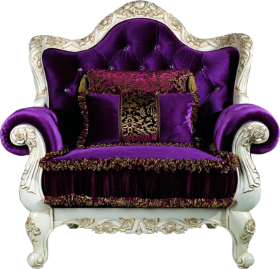
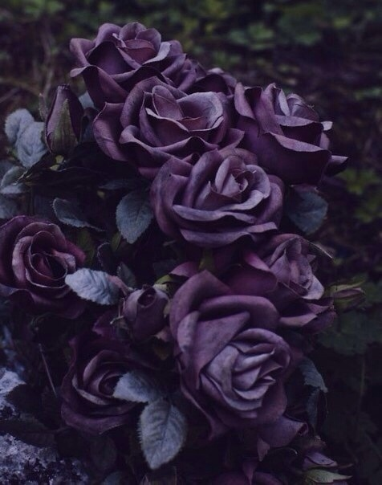
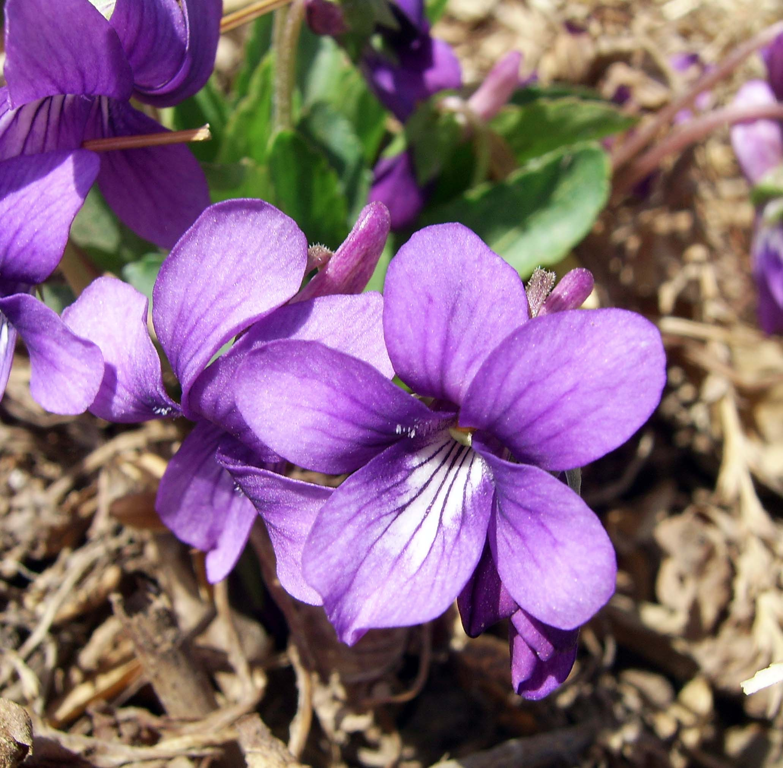
Violet
Spiritual
Dignified
Stately/Royal
Vigorous
Disagreeable
Melancholy
Despondent
Unhappy
Depressing
Sad

Slide 9
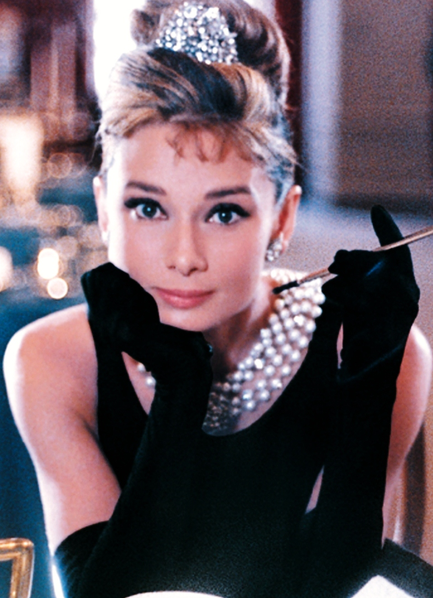
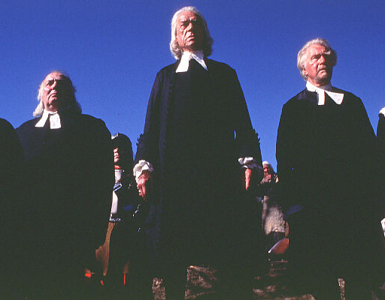
Black
Sad
Melancholy
Vague
Unhappy
Fearful
Old
Heavy
Distressed
Dignified
Stately
Strong
Powerful
Glamorous

Slide 10
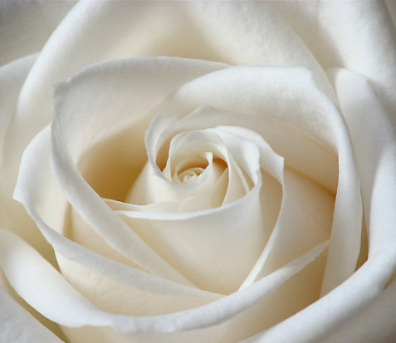
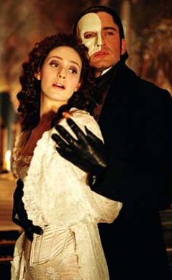
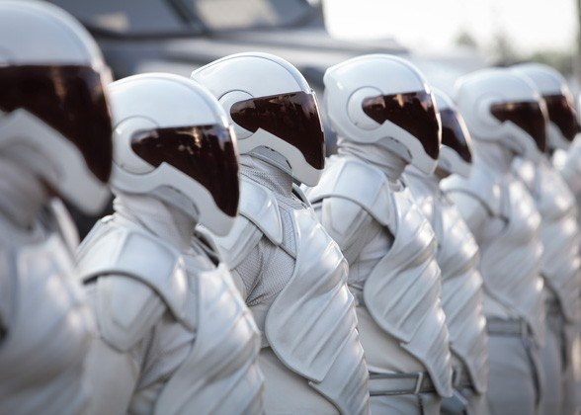
White
Purity
Innocence
Tender
Soothing
Solemn
Empty
Sterile
Unfriendliness
Coldness
Barred (Barriers)

Slide 11
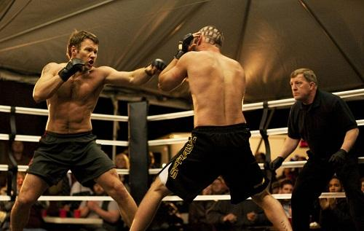
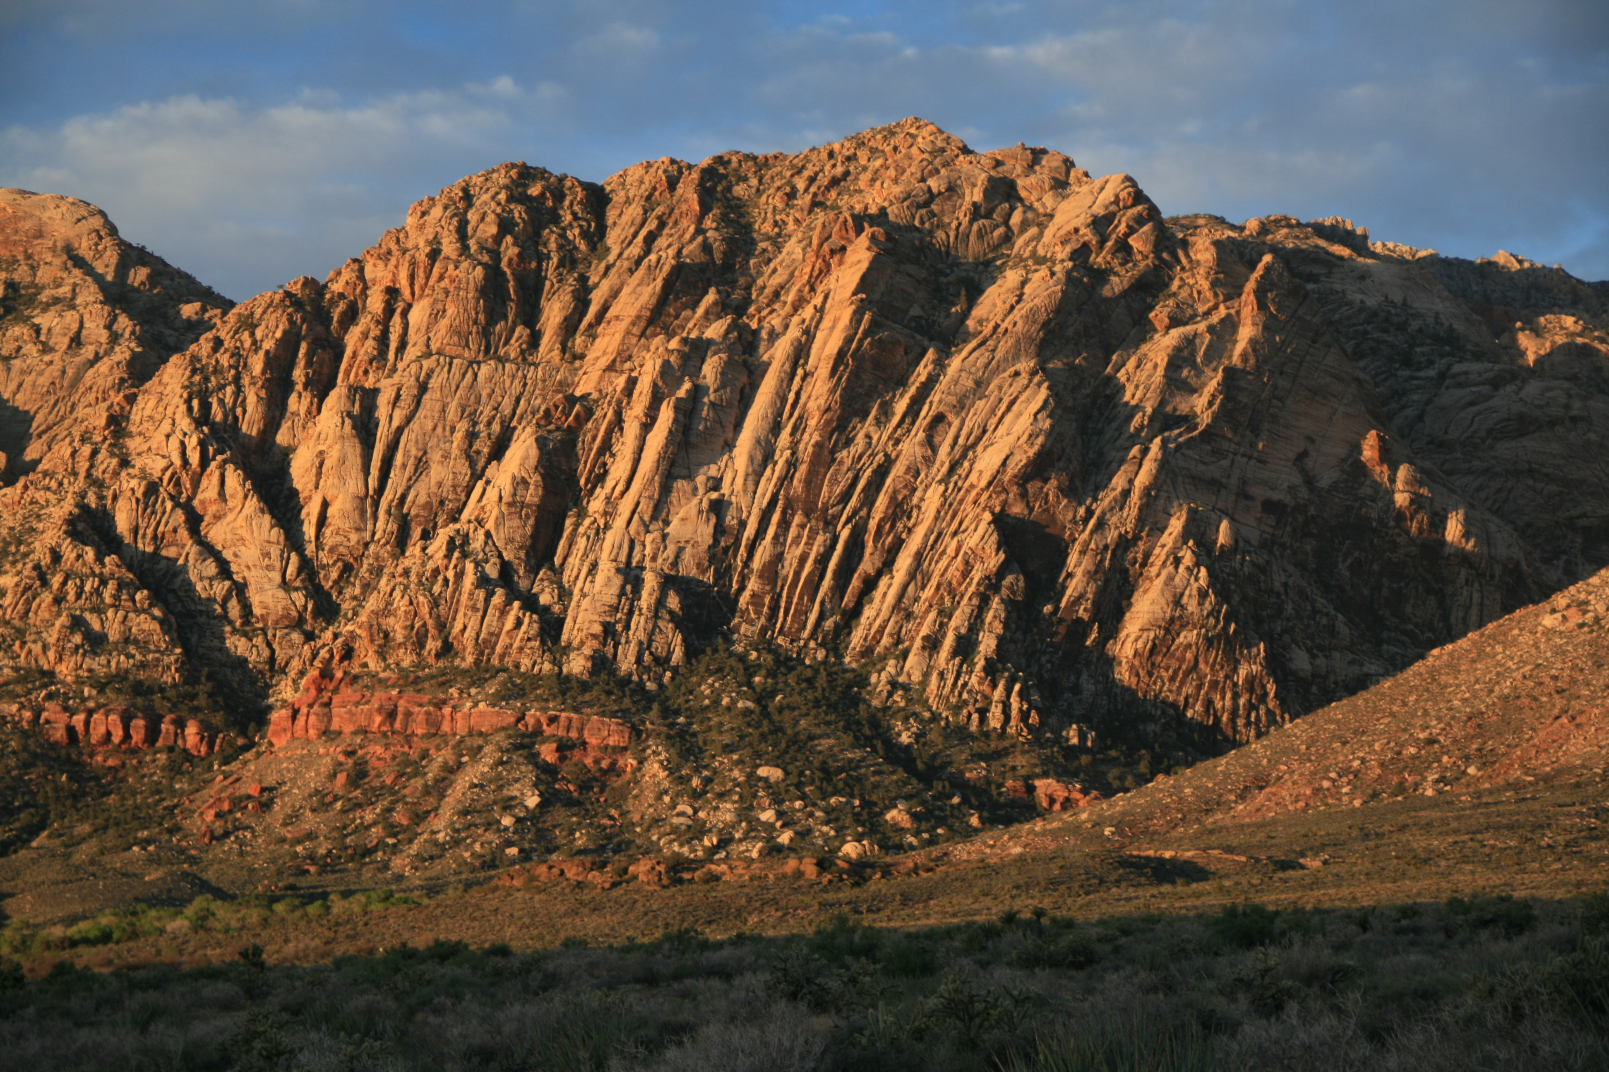
Brown
Secure
Comfortable
Reliable
Earthy
Full
Sad
Dirty
Disagreeable
Lack of Sophistication
Notes:
Crazy how many meanings each color can have.

Slide 12
Color Terminology
Color—brought to you by light! Light waves of a certain length stimulate retina (in eye) which signals to the brain what we perceive as color.
Hue—quality that differentiates one color from another (ex-blue vs. green vs. yellow)
Saturation—amount or percentage of a hue in a color mixture. (ex-fire engine red=high saturation, dusty rose=lower)
Value—relative lightness or darkness of color. (ex powder blue=high value, dark brown=low value)
Tint—color with a high value. Usually achieved when mix color with white (light)
Shade—color with low value. Usually get from mixing one or more hues and black.
Notes:
These terms give a little more nitty gritty break down of what color is. Know these terms. This is vocab that designers, artists need to understand to work effectively in professional world. Even if not planning to pursue prof design career, this vocab is a great thing to have in your mental toolkit—plus these might show up on test.

Slide 13
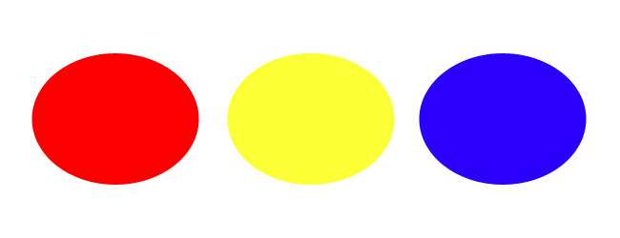
Primary Colors
Red, Yellow, Blue
Can’t be made/blended from any other colors.

Slide 14
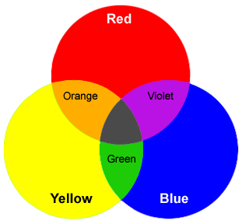
Secondary Colors
(These function differently when working with light—just know that…)
Secondary colors are made by mixing two primary colors
In pigment (not light), the colors made are Purple (or Violet), Green, & Orange.

Slide 15
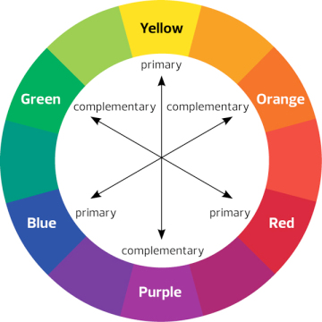
Complementary Colors
Notes:
Opposite each other on the color wheel. They accent one another, cause other to POP!

Slide 16
I GET IT!!! Color communicates. So what?
How can a designer manipulate the audience’s perception of the colors they’ll see onstage?

Slide 17
Manipulation 101
There are general “rules” of color use that artists and designers abide by.
For example: Set designs often done in medium saturation. This allows the set to fade a bit more into the background where it can support the storytelling coming through the costumes, lights, sound, etc....
Costume—often more free with their color saturation and choices, because costumes draw attention to the characters. Main rule for costume design is that color choices should support the character (or the version you want to portray).
However! Really good designers know how to break rules in a way that can support a concept.

Slide 18
Manipulation 101
Color Proximity— The placement of one hue in relationship to another.
How far apart or close together colors are, etc…
Manipulation Hint: The spatial relationships between specific hues (especially contrasting colors) have a great impact on an audience’s perception of a scene!!

Slide 19
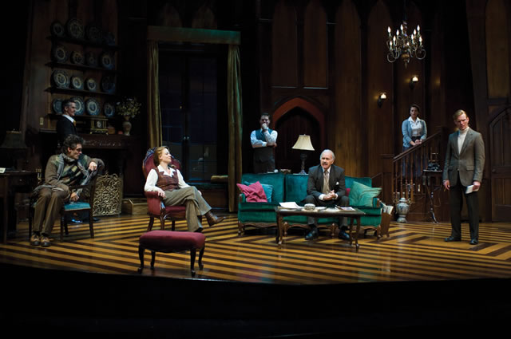
Notes:
Just from looking at color contrast, do the people stand out more or the set? What effect does that create??
This is a scene from The Mousetrap done at USF a few years back. This is a murder mystery. While the characters are what drive the story, the color choices for the set make it a contstnat focal point, this gives the effect that **characters are overwhelmed by the world they’re in. Environment=eccentric, maybe volatile or violent. They are at the mercy of the environment (trapped in snow storm, never know where killer may be lurking)
Manipulation Tip: Strongly contrasting colors (patterns) create greater dynamic tension than less conflicting hues.

Slide 20
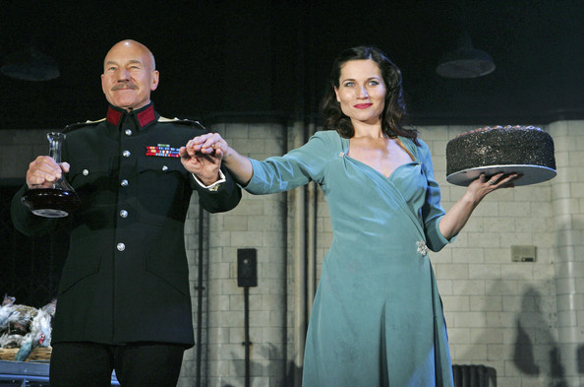
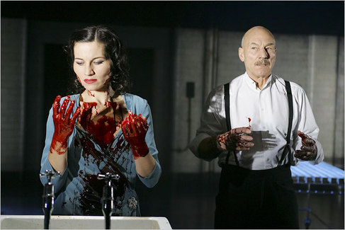
Notes:
Huge Manipulating Device: Adding contrasting pops of color to a stage picture to highlight the things the designer wants you to read into.
This picture is different because surroundings are intentionally muted, cold, grey, so that pops of contrasting color show up on the people, can highlight specific attributes about the CHARACTERS.
What colors stand out here? Where/How do we see them? What could it signify about the characters—based on what we know about red and based on their placement?
Red—power, aggression, energy. Lady M—lips, her words are her weapon, her power source. Macbeth’s is on his collar, what could this color placement mean?neck controls the head, almost like he’s being controlled by power. (maybe her power) who looks more in control.

Slide 21
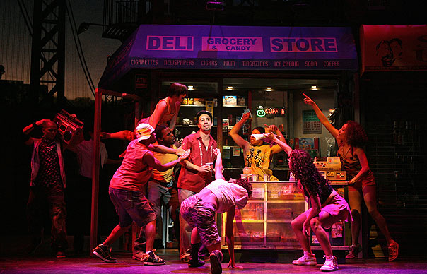
Notes:
Color can show simultaneous diversity a unity in an environment/group of characters.
Contrast is there, but it’s cohesive it gels, not off putting.

Slide 22
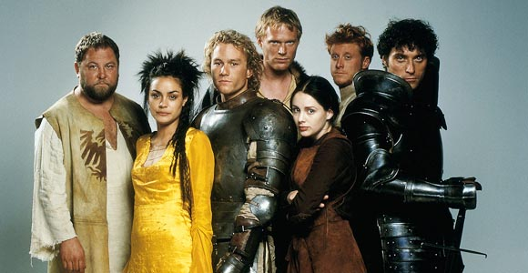
Notes:
Can also show divisions or distinction among characters.
What colors stand out to you the most in this image? Do you feel like they should be together?
What group does william belong in? In movie, William exists between both world, with the rich and the poor—his color shows strength, power, but more rugged, rudimentary version.
Count Adamar also shows strength and power in color. But what does the color suggest most strongly in this image?

Slide 23
In your scripts…
What is the environment of your play?
Is it one location the whole time? Several?
Do you want your characters to stand out more or their environment?
What color choices could you make with your set to support the things you want to emphasize?
What moods do you want to establish? What colors capture that mood? Why?
Notes:
Have students get out their scripts and work on answering these questions. 10ish mins, Bring ‘em back in, check in randomly with students. Workshop as a class.

Slide 24
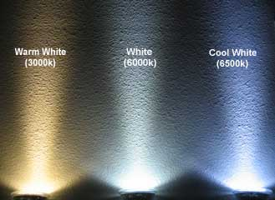
Terra Nova Color Analysis
Environment of the Play: “Frozen whiteness of Antarctica” is the primary location

