Slide 1
Elements Of Design & Principles of Composition
Good stuff to know.

Slide 2
ELEMENTS OF DESIGN

Slide 3
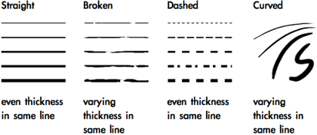
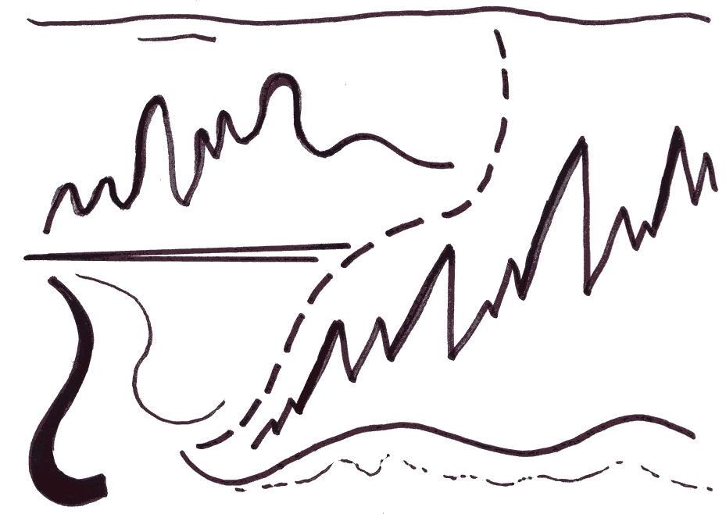
Line

Slide 4
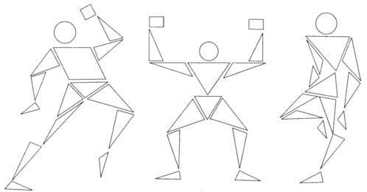
Shape

Slide 5
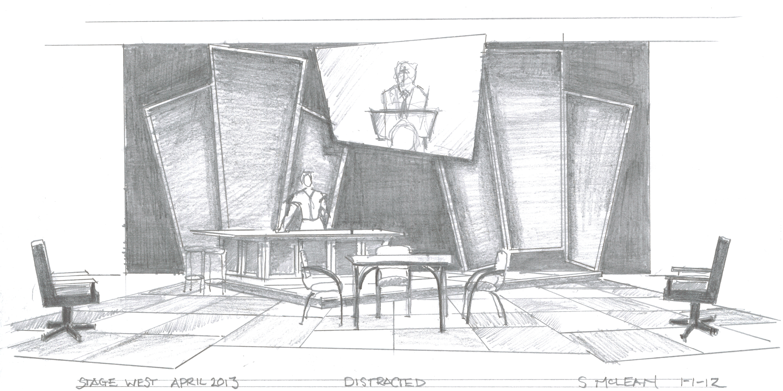
Mass

Slide 6
Texture

Slide 7
PRINCIPLES OF COMPOSITION

Slide 8
Unity

Slide 9
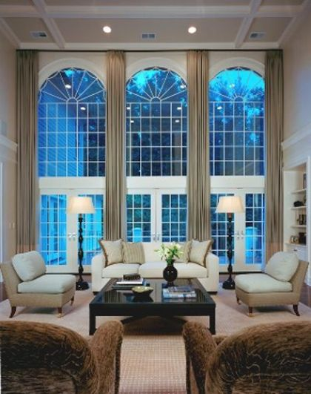
Harmony

Slide 10
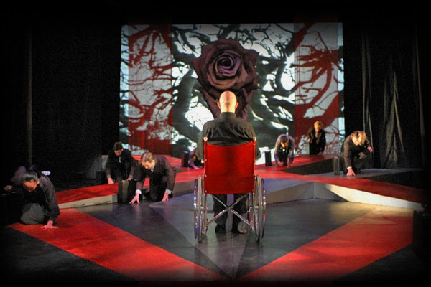
Contrast
Notes:
Kim A. Tolman Design Richard III

Slide 11
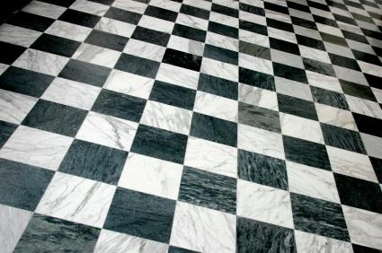
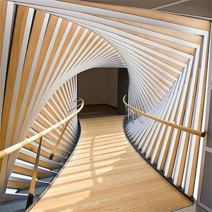
Variation

Slide 12
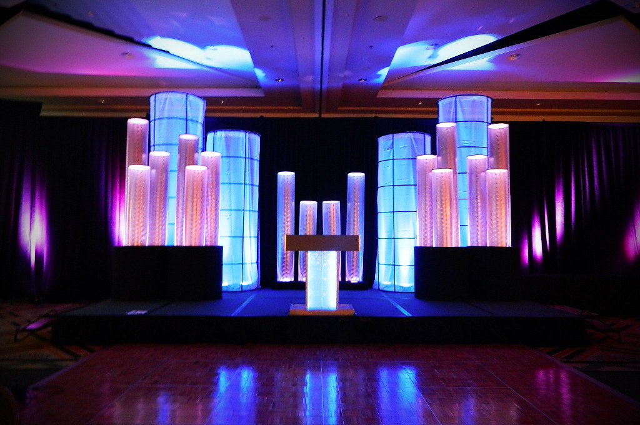
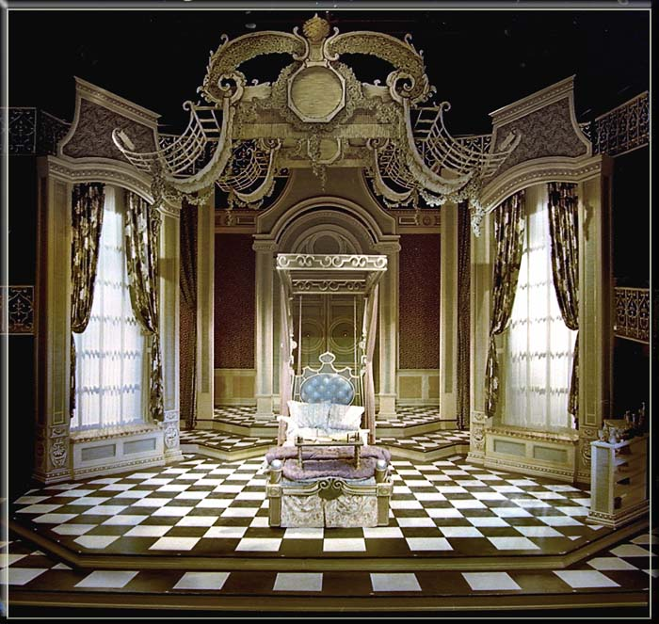
Symmetrical Balance

Slide 13
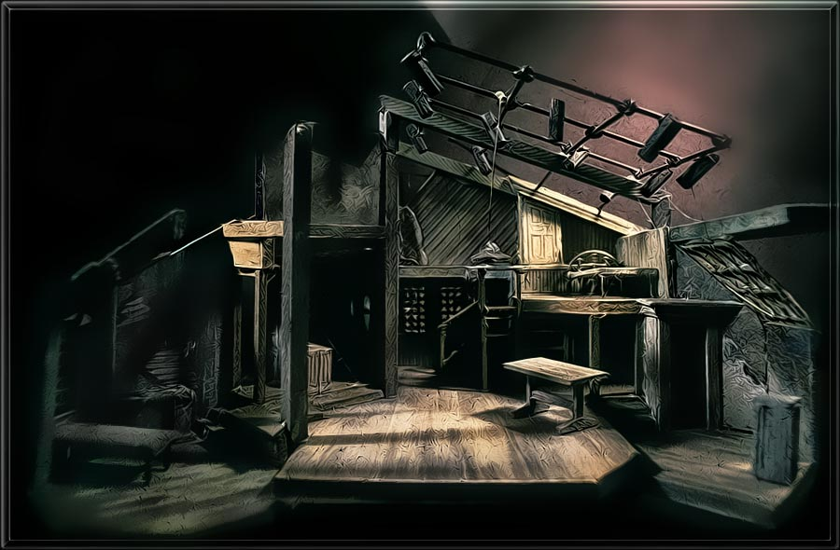
Asymmetrical Balance
Notes:
The Diary of Anne Frank designed by Richard Finkelstein

Slide 14
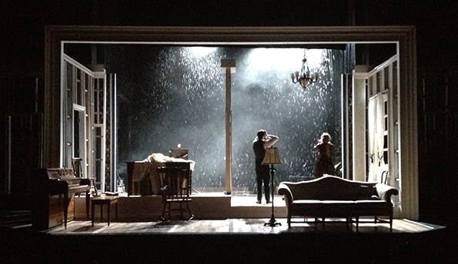
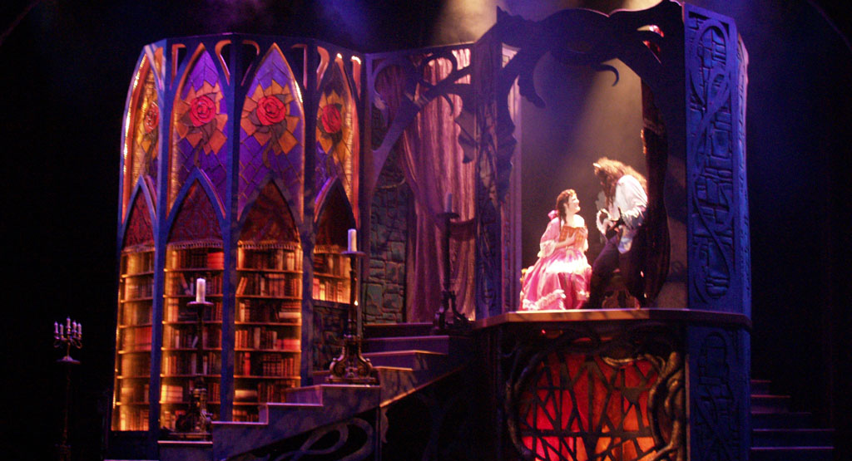
Emphasis

