Slide 1
Prepare to Analyze!!!

Slide 2
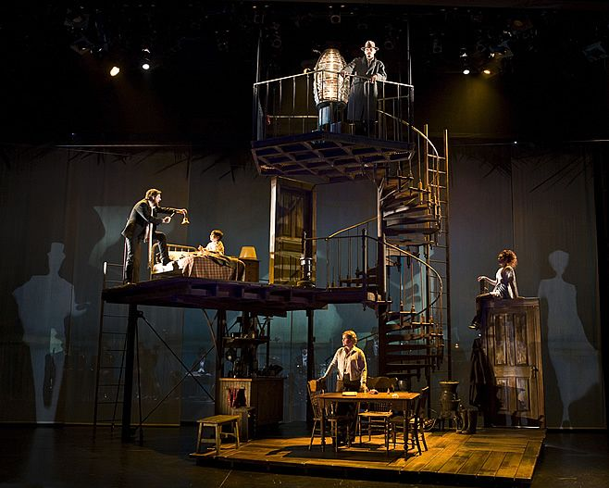
Notes:
The Whisper House-Michael Schweikardt

Slide 3
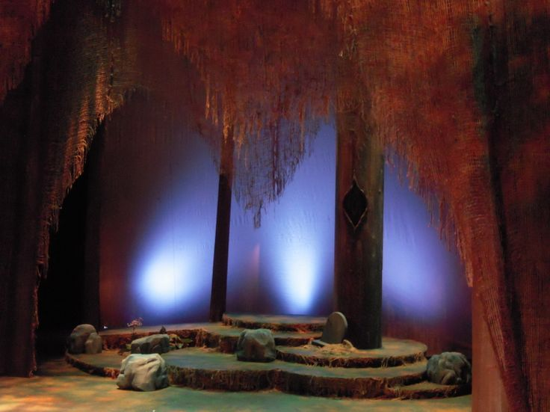

Slide 4
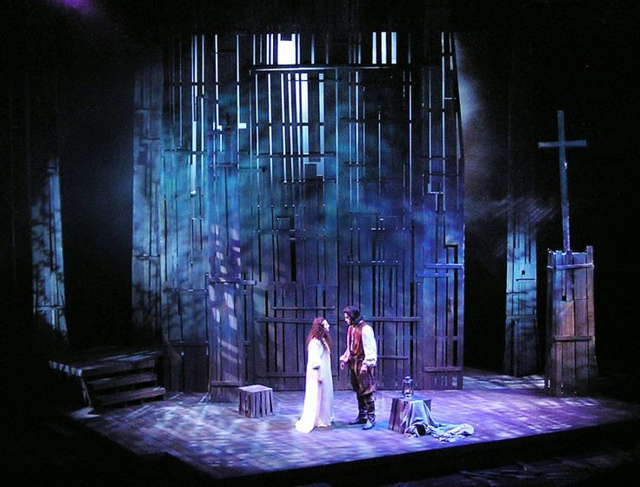

Slide 5
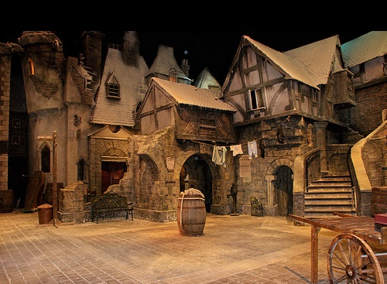

Slide 6
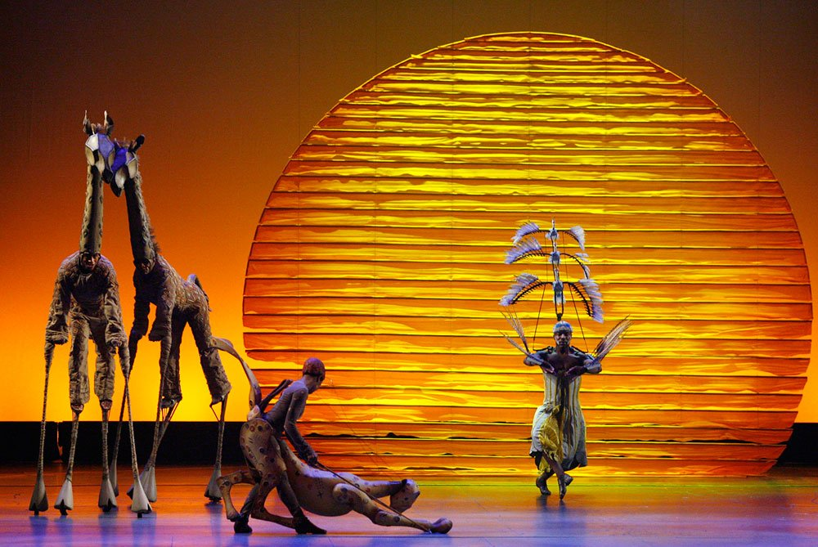

Slide 7
Notes:
Analyze for Principles of Composition

Slide 8
