Slide 1
Character Profiling

Slide 2
What is Character Profiling?
“Characterization: making the characters seem vivid, real, alive… [character profiling] is simply a tool for organizing your thoughts about a certain character and keeping track of a particular character’s idiosyncrasies and relationships.” -The Lazy Scholar (Internet Writing Journal 1998)
Taking a character you’ve read about on a sheet of paper and giving it dimensions; giving it life.
What do you have to know to create a character profile?...

Slide 3
Background
The total of a persons experience, knowledge, and education.
Birthplace? Family? Talents? Job?
Coming up with solid background information is essential, and gives the actor/writer a firm foundation to expand upon.

Slide 4
Personality
Personalities are combinations of characteristics or qualities that form a distinctive character.
Primary motivators
underlying goals
drives to action
Some examples are: chaos, achievement, power, honor, discovery, education, balance/peace, and play.

Slide 5
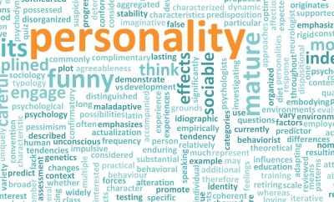

Slide 6
Physical Attributes
Something attributed as to belonging to a person, thing, group, etc; a quality, character, characteristic, or property
people are defined by the way they walk, talk, sit, stand, eat, laugh, etc.
People know you because of your physical attributes
Ex: “I knew it was you because of the way you turn out when you walk”
An actor should have different physical qualities for every character they play
Physical Attributes help the audience to recognize a character
Ex: Johnny Depp, Meryl Streep

Slide 7
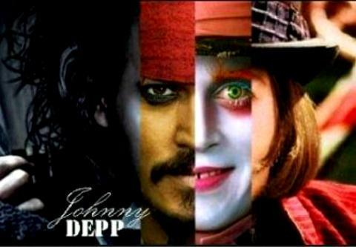
http://images5.fanpop.com/image/photos/31900000/Johnny-3-johnny-depps-movie-characters-31992881-480-333.jpg

Slide 8
Quirks/Major Flaws
“To be genuine and memorable, characters need to have both quirks and flaws.” -Kella Campbell
Quirk: an unusual habit or way of behaving/ a peculiar trait
Flaw: a defect in physical structure or form/ an imperfection or weakness and especially one that detracts from the whole or hinders effectiveness.
FLAWS NEED TO BE OVERCOME, QUIRKS DO NOT.
What are some flaws? Some quirks? Can you think of any characters with flaws and quirks?
https://www.youtube.com/watch?v=cC_jddH_0MI (50)

Slide 9
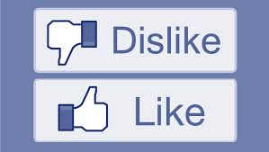
Likes & Dislikes
What does your character like?
What does your character dislike?
food, activities, objects, colors, social situations, etc.

Slide 10
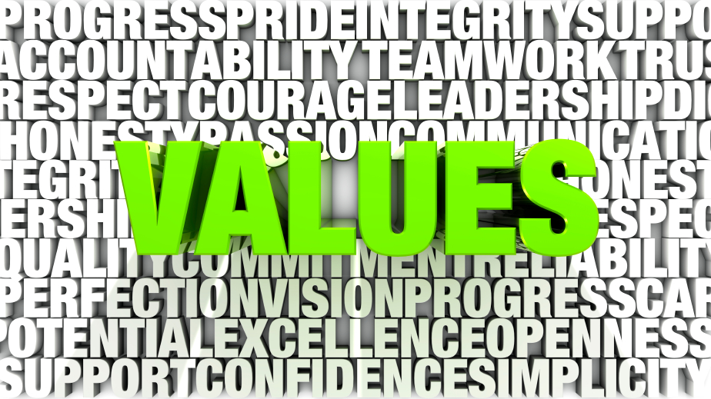
Political Views and Values
Value: The worth of something in terms of the amount of other things forwhich it can be exchanged or in terms of some medium of exchange.
Standards: those morals, ethics, habits, etc., established by authority, custom, or an individual as acceptable; a rule or principle that is used as a basis for judgment
Politics and religious views cause conflict
religion affects your views and values

Slide 11
Objectives
Something that one’s efforts or actions are intended to attain or accomplish; purpose; goal; target:
What are your character’s goals in life?
temporary and long term
tactics to achieve goals
Harry Potter video clip

Slide 12
Relationships
A connection, association, or involvement
help or block a character from achieving their objective
What has happened with other characters in the script up to the beginning of the play
How do certain relationships in your life create conflict?
The views/values, quirks, flaws, etc. in other characters affect your character

Slide 13
“Proof”
– David Auburn
CATHERINE: I lived with him. I spent my life with him. I fed him. Talked to him. Tried to listen when he talked. Talked to people who weren’t there . . . Watched him shuffling around like a ghost. A very smelly ghost. He was filthy. I had to make sure he bathed. My own father . . . After my mother died it was just me here. I tried to keep him happy no matter what idiotic project he was doing. He used to read all day. He kept demanding more and more books. I took them out of the library by the carload. We had hundreds upstairs. Then I realized he wasn’t reading: he believed aliens were sending him messages through the Dewey decimal numbers on the library books. He was trying to work out the code . . . Beautiful mathematics. The most elegant proofs, perfect proofs, proofs like music . . . Plus fashion tips, knock-knock jokes – I mean it was nuts, OK? Later the writing phase: scribbling nineteen, twenty hours a day . . . I ordered him a case of notebooks and he used every one. I dropped out of school . . . I’m glad he’s dead.

Slide 14
bibliography
http://kellacampbell.wordpress.com/2014/01/24/of-quirks-and-flaws/
http://www.merriam-webster.com/dictionary/background
http://rpg.ashami.com/
http://www.wikihow.com/Create-a-Highly-Detailed-Character-Profile
http://www.dictionary.com/

