Slide 1
Arthur Miller
By: Michaella Scholz

Slide 2
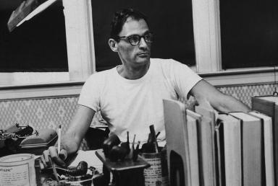
Young Childhood and Adolescent
1915 – Born in Harlem, New York
Father was a coat manufacture
Mother was an educator
The affects of Wall Street Crash of 1929
University of Michigan
“No Villain”
Notes:
Arthur Miller was born on October 17, 1915 in Harlem. New York. He was born to a Jewish-Polish Family. His father Isidore, owned a coat manufacture business. Arthur was closest to his mother, Augusta, who was an educator and loved novels. In 1919 when Wall Street crashed his family lost everything and had to move from Manhattan to Brooklyn. Arthur saved up through working odd jobs to put himself through college. He attended the University of Michigan and wrote for the school paper and he completed his first play, No Villain.

Slide 3
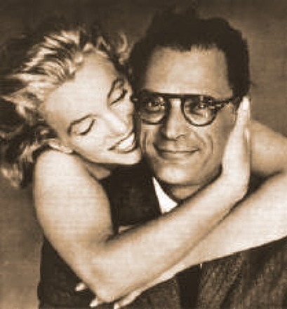
Adulthood
The Man Who Had All the Luck (1944)
All My Sons
Death of a Salesman (1949)
The Crucible
Mary Grace Slattery, Marilyn Monroe, Ingeborg Morath
Notes:
The Man Who Had All the Luck was Miller’s first performance on Broadway and was a considered a complete failure. After this he almost gave up, but he gave himself one more try. But three years later All My Sons, a play about a manufacture of war materials, won the New York Drama Critics' Circle Award as the best play of 1947. Death of a Salesman was the play that secured Miller’s reputation as a prolific American Playwright. This was because Death of a Salesman won him a Tony and a Pulitzer Prize. The Crucible was his next big work and it received a lot of mixed reviews because it was a commentary on the Anti-Communist Movement. Arthur Miller than saw himself being black-listed by the House Un-American Activities Committee who found him to be a communist. During the time when he was writing all these people he married three women Mary Grace Slattery, Marilyn Monroe, Ingeborg Morath. He had two kids with Mary before they were divorced. He was married to Mary Ingeborg till he died and in that time he had two kids.

Slide 4
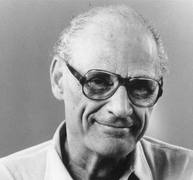
Death
Dies in 2005 at the age of 89
Cancer, Phenomena, and Congested Heart Failure
The Guardian and the New York Times
Notes:
Arthur Miller dies at the age of 89 in April 10, 2005 at his home in Roxbury, Connecticut. Miller died because he had been suffering cancer, phenomena, and congested heart failure. His wife died in 2002 but his four children survived him. The Guardian and the New York Times and other big papers all reported of his death and claimed that America had just lost a giant in American Playwrighting.

Slide 5
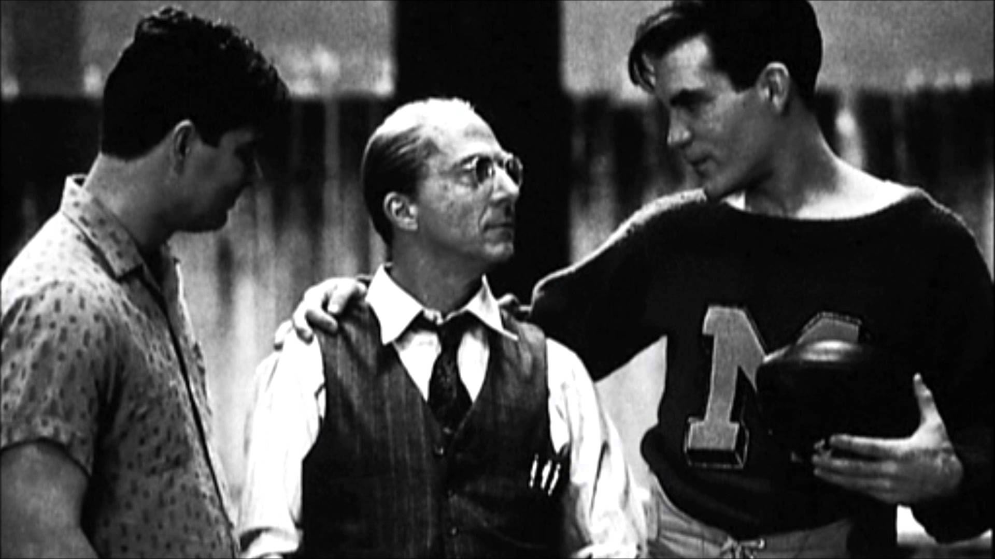
The Death of a Salesman
Play Synopsis – The story of Willy Loman
Themes of identity loss and turning points
Arthur Miller’s personal feelings
Notes:
The play Death of a Salesman follows the Loman family and in particular, Willy Loman. Willy is a salesman who wants to be thought of as the best. Willy wants everyone to think he is an amazing salesman, father, and husband but he is not. Through falling through with sales and an affair others see that Willy is not what he wants to be. Throughout the play Willy fantasizes and forgets what is actually happening which confuses him thoroughly. The play ends with Willy committing suicide and his funeral. Miller bases Willy off of some of his uncles who were salesmen. But the main idea is how events can thoroughly affect one’s self and deals with the loss of identity and not being able to find one’s place. It seems that Arthur Miller could have been experiencing these feelings because before this play he was considered a failure, he hadn’t written something worth producing. He was a unrecognized writer. It is said that people like this play because it is a mirro to one’s self but I think it could also be a window into Arthur Miller.

Slide 6
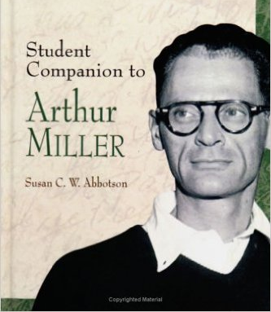
Arthur Miller is the Great American Playwright because…
He is an American Historian
He made it in America
His influential works
Notes:
Arthur Miller is the Great American Playwright because he took things from American history and documented them in way that made us think. He lived through a Wall Street crash, the Depression, and through the Anti-Communist movement. He took feelings and ideas from these events and wrote them into his work, getting America thinking. He also was able to perpetuate the idea of the American Dream. He could’ve given up on his dream to be a writer, but even when he was down on his luck he kept trying and eventually made it in America. He took America head on and became the writer he wanted to be and while doing that made us think about who we are and what we are doing here. Although he has passed away he still is influential ad we still talk about his plays and use them in schools. He lives on as the Great American Playwright.

Slide 7
Bibliography
http://www.biography.com/people/arthur-miller-9408335#playwriting-career
http://www.gradesaver.com/author/arthur-miller
http://www.shmoop.com/arthur-miller/timeline.html
http://www.theguardian.com/film/2005/feb/11/usa.theatre1
http://www.cliffsnotes.com/literature/d/death-of-a-salesman/about-death-of-a-salesman

