Slide 1
Production Design
A Quick Look

Slide 2
Director
Step 1: Read the Play (and then read it 10x more)….And read it more than that.
Step : Choose a Theme – What are you going to say with this production
Step 3: Develop a Concept – Unique interpretation of the Play
Step 4: Find a visual Representation of Production
Step 5: Share Concept, metaphor, and “viz” with production team
Step 6: Direct production team and actors to present a unified production

Slide 3
Theme
Ask yourself what you think/want this play to say? What is the message that comes across? What is important to you and your production?

Slide 4
Concept
Unique interpretation of the play.
  No concept is the same
Purpose
  Provide design, blocking, and character choices
  How are you going to tell the story?

Slide 5
Ask Yourself
Do you want to be loyal to the setting and time period or will changing it best tell the story?
Is there a symbol in the piece you want to focus on?
What will be the best way to convey the story?

Slide 6
Examples
The Comedy of Errors is like a circus.
Hairspray is like a time machine to the 60’s
Steel Magnolias is a timeless portrayal of female friendships
Peter Pan is a steam-punk children’s story.

Slide 7
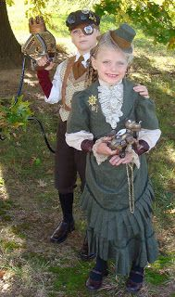
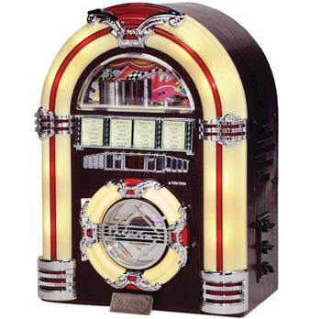
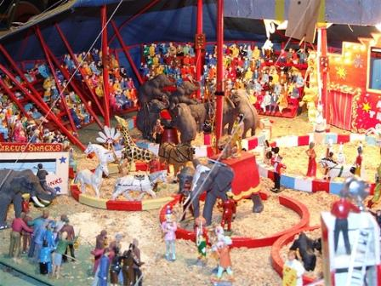
“Viz”

Slide 8
Costume Designer
Step 1: read the play
Step 2: research based on directors concept
Step 3: Choose inspiration pictures
Step 4: begin drawing sketches/renderings based on characters
Step 5: finalize sketches/renderings with Director

Slide 9

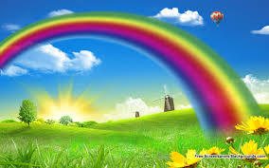
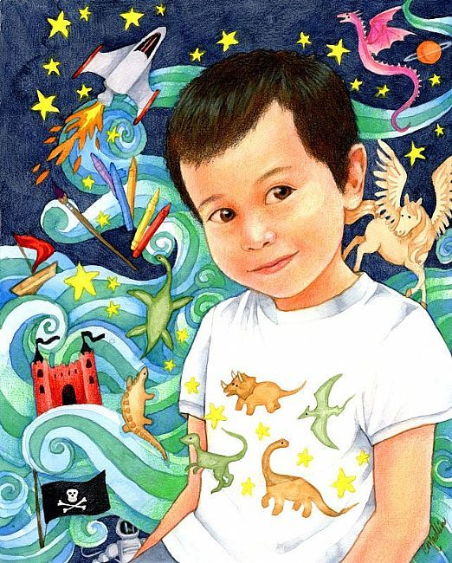
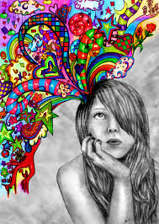
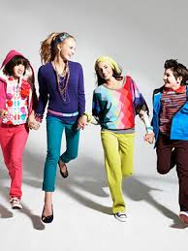
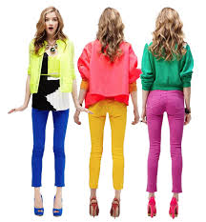
Inspiration pictures

Slide 10
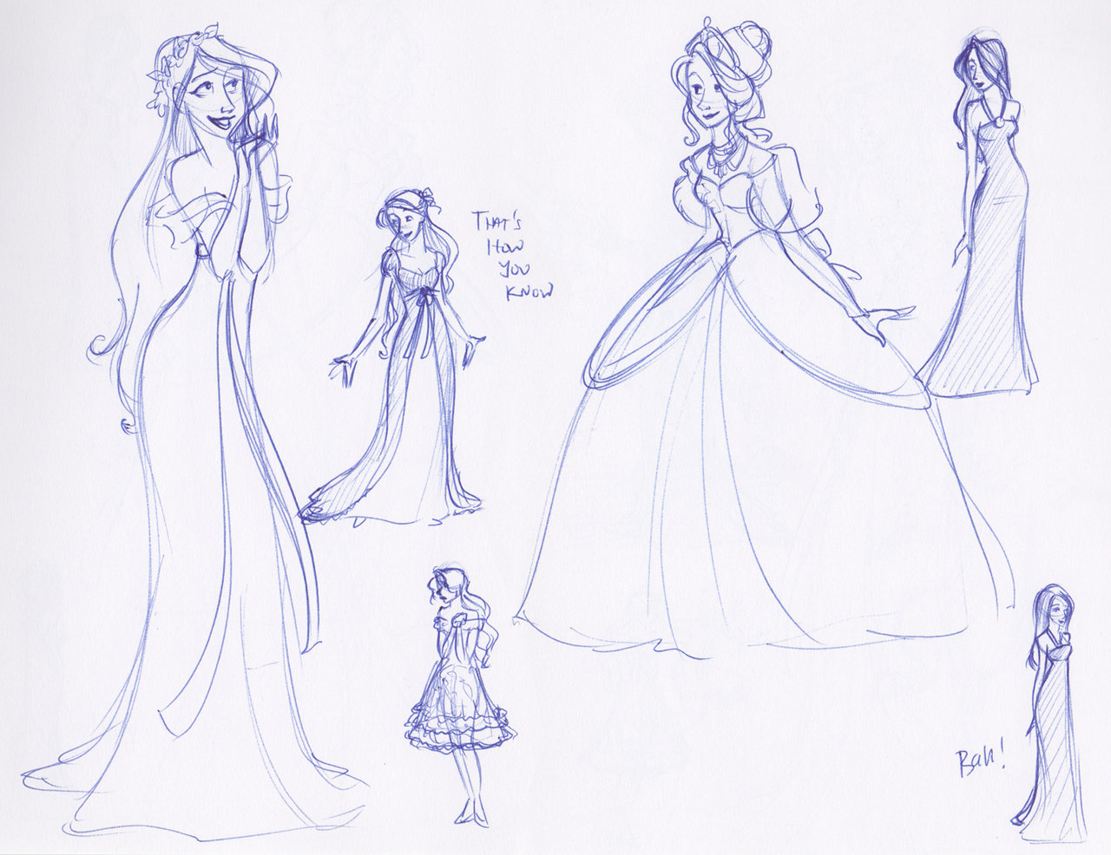
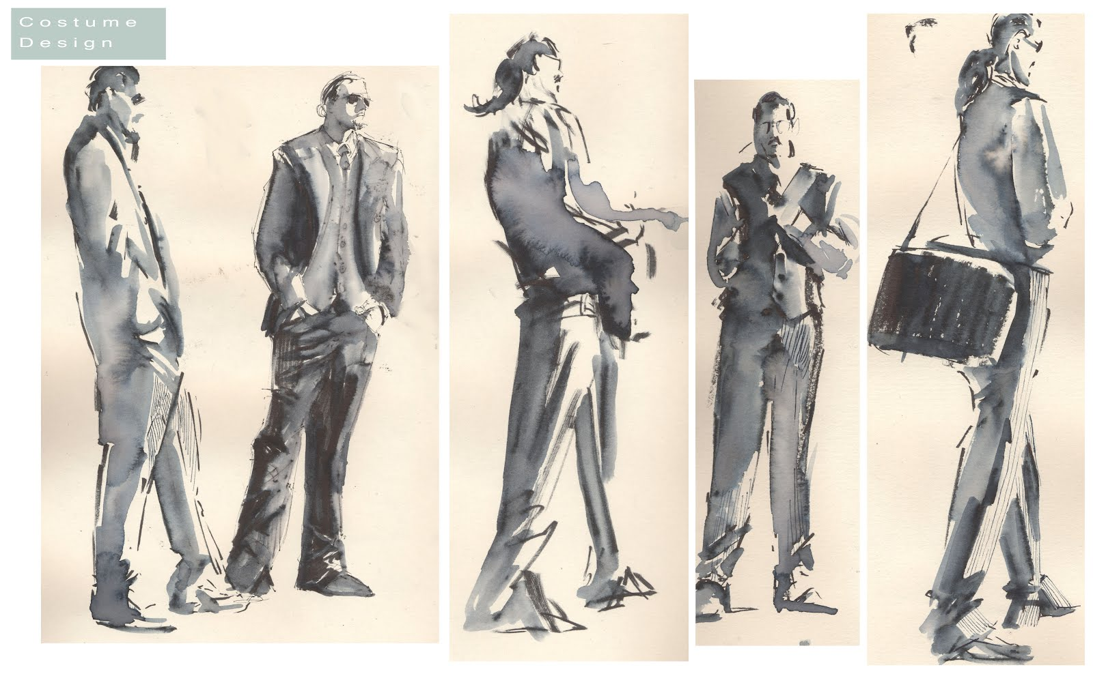
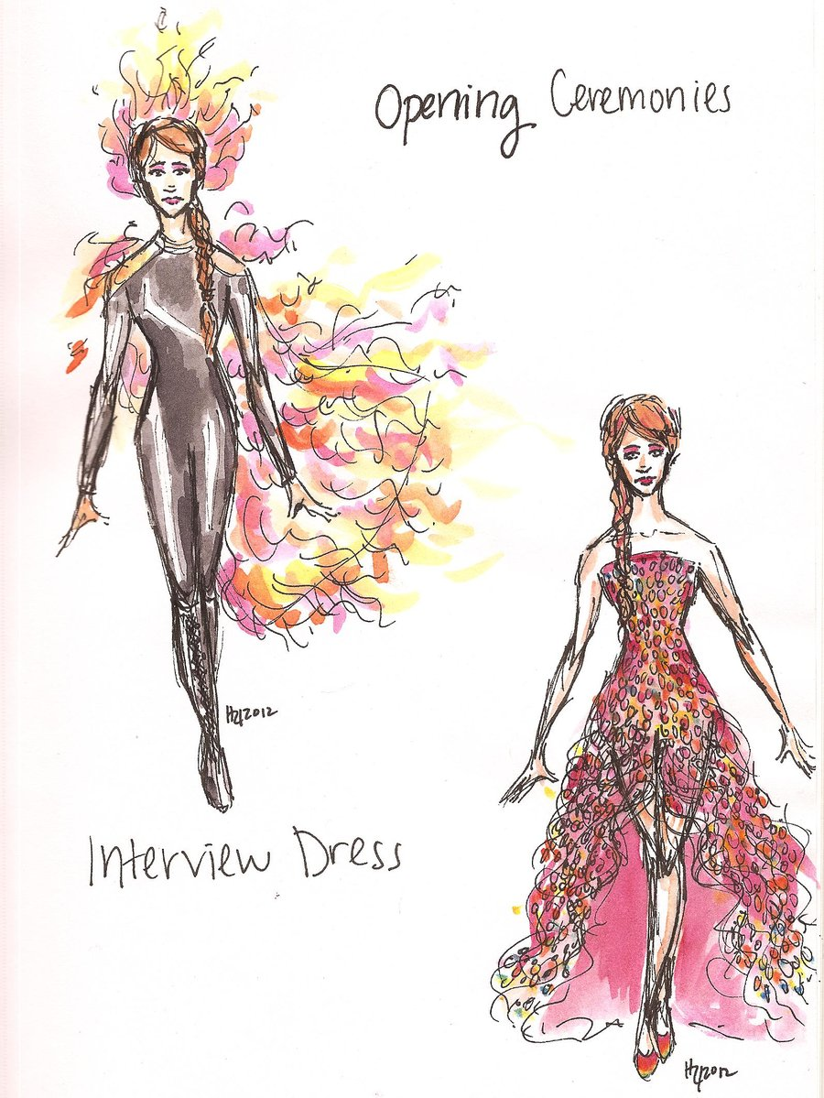
Sketches

Slide 11
Set Designer
Step 1: Read the Script
Step 2: create a basic floor plan (necessities)
Step 3: Find inspiration
Step 4: 3-D color model of design

Slide 12
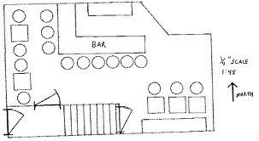
Floor plan Necessities

Slide 13
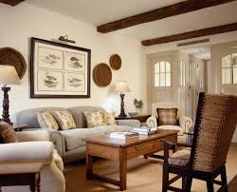
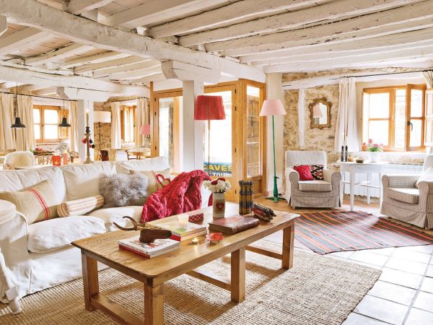
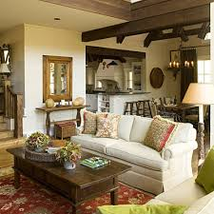
inspiration

Slide 14
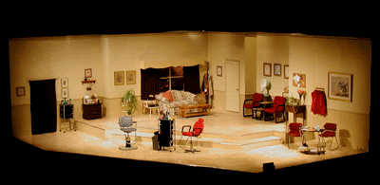
3d color model

Slide 15
Lighting designer
Step 1: read the play
Step 2: outline written in lighting
Step 3: get inspiration pictures
Step 4: create light plot

Slide 16

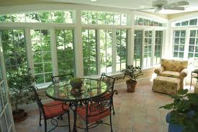
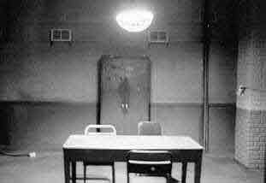
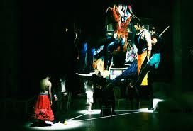
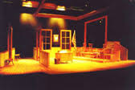
Inspiration Pictures

Slide 17
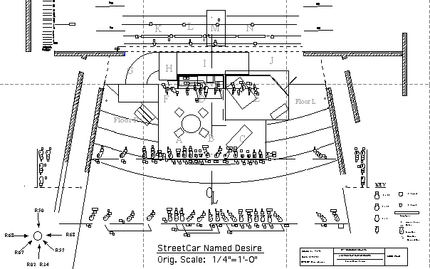
Lighting Plot

Slide 18
Now What?

Slide 19
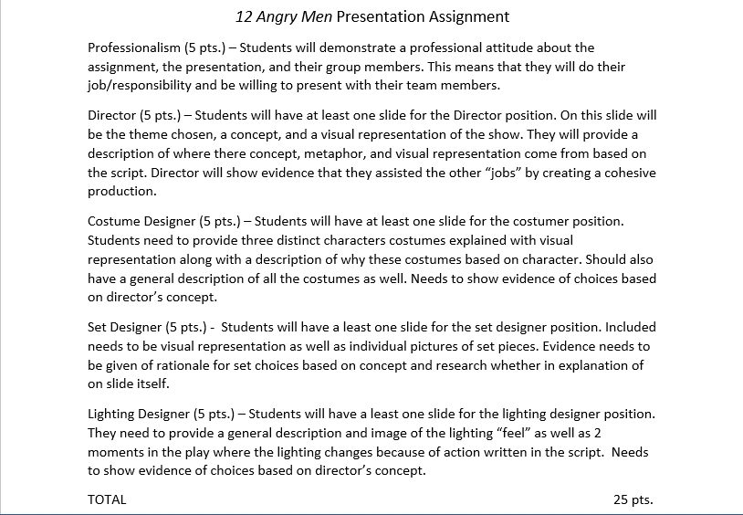

Slide 20
Example Presentation

Slide 21
Peter Pan
A steampunk storybook

Slide 22
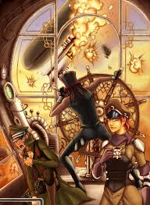
Director
Theme: Sometimes we need to hold onto our youth
Concept: Peter Pan is a steampunk storybook
“viz”

Slide 23
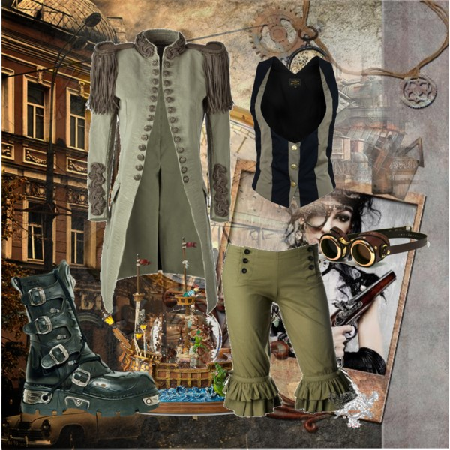
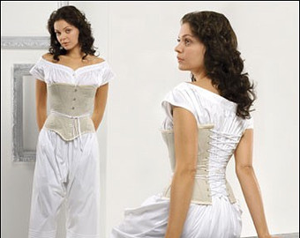
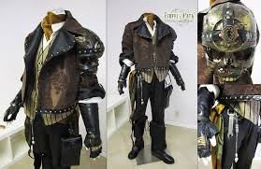
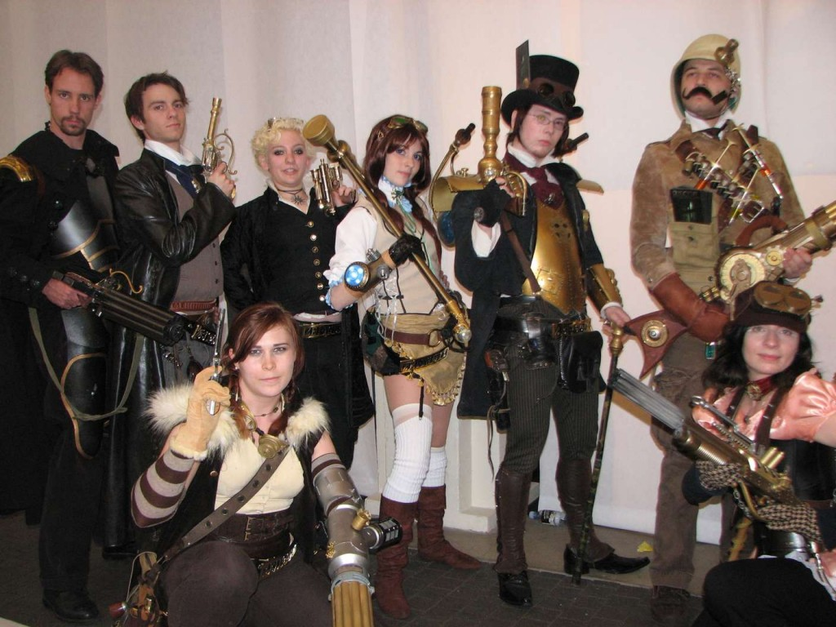
Costume Designer
Peter Pan
Wendy
Captain hook

Slide 24
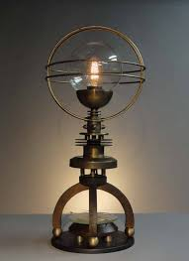
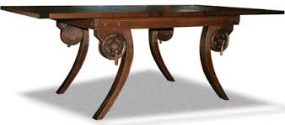
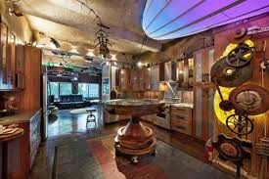
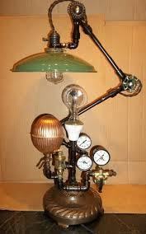
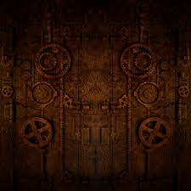
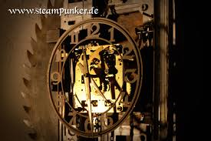
Set Designer

Slide 25
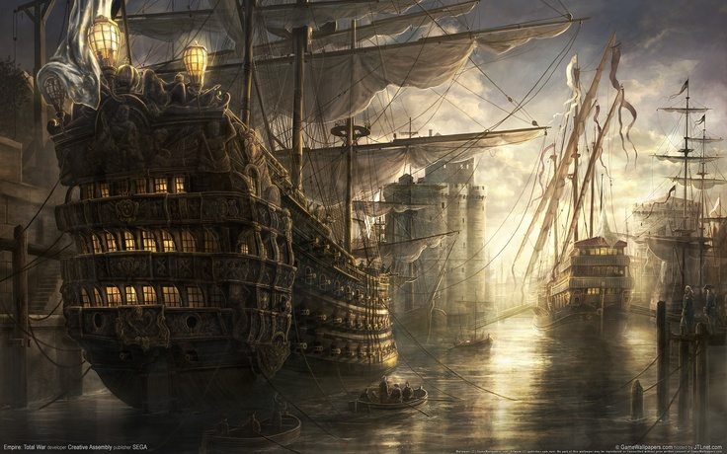
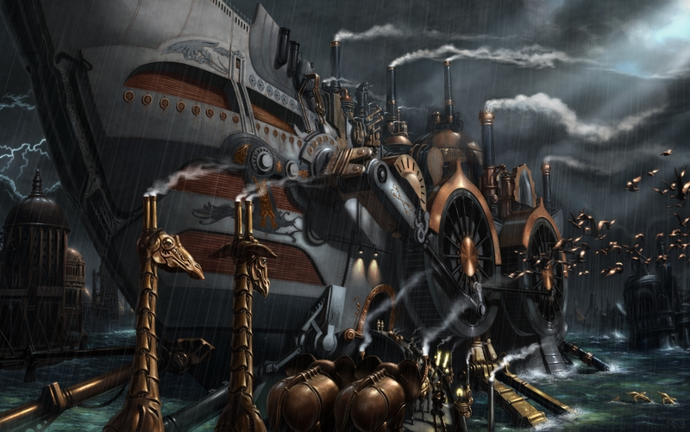
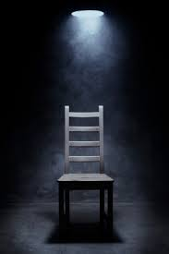
Lighting Designer

