Slide 1
Greek Theatre

Slide 2
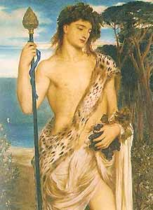
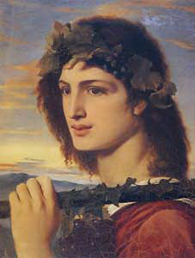
Dionysus
God of wine, theatre, revelry, and fertility
Also known as Bacchus by Romans
Born from the thigh of Zeus (twice born)
Instructed on winemaking
Greek theatre came out of the worship of Dionysus
Major Theatre festival was called City Dionysia

Slide 3
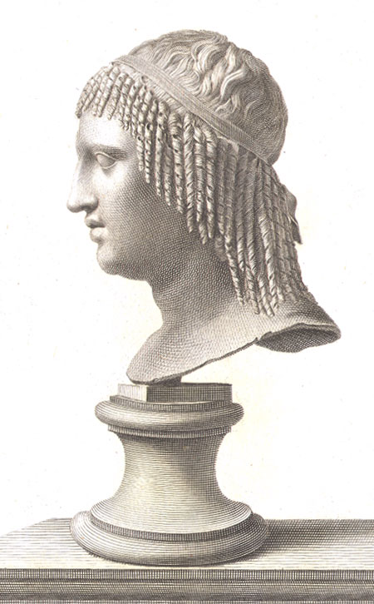
Thespis
According to Aristotle and others he was the first actor to appear on stage
Other sources say he introduced the first character OTHER than the chorus.
Was a singer of dithyrambs (songs about stories from mythology with choric refrains)
Introduced idea of masks to portray different characters.
Won the first tragedy competition
One of the first to tour
Invented western theatre as we know it.
Thespians

Slide 4
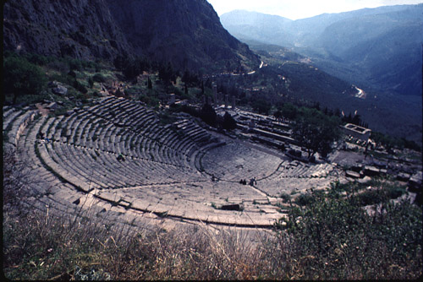
Greek Amphitheatre
Open air space using sloped hillside for seating
Placed near sanctuaries
Orchestra – “the dancing space” for the chorus, chief performance space, circular.
Thymele - An alter to Dionysus was generally placed in the middle of the orchestra
Theatron – “the seating place” semi-circled terraced area with benches (built with wood or stone)
Sight not great but acoustics excellent, words spoken silently in orchestra could be heard all the way up.

Slide 5
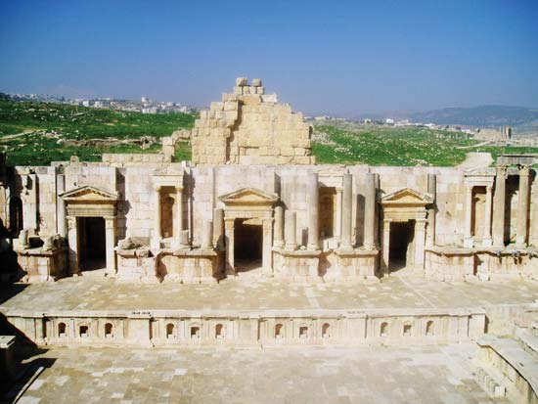
Skene – “tent” covered structures where actors stored costumes and masks (originally temporary wood structure eventually stone) and performed quick changes out of sight.
Central doors
Upper platform
Paraskenia – “beside the skene” wings on the side
Chorus stayed in the orchestra but actors used skene to make entrances and exits
Proscenion – platform in front of the skene
Parodos – “passageways” actors took to enter and exit the proscenion. Ramps on the side of stage between skene and audience.
Machines inside skene
Aeorema – crane for God’s entrances
Periactoi – pillars that turned to change the scene
Ekeclema – carts to carry in dead because murder or suicide was not performed onstage.

Slide 6
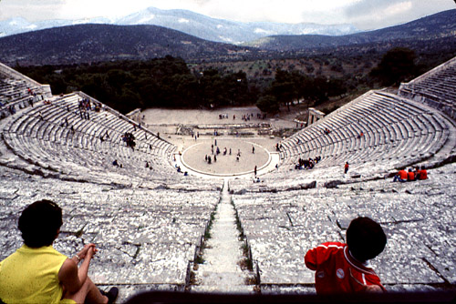
Audience
Preferential seating given to priest, magistrates, and dignitaries – front row center
Tickets were marked with Greek letters to indicate certain wedge of seats
Cost about the price of an unskilled mans wages for one day.
Could apply to get the $ for tickets
Most likely only men in attendance.

Slide 7
Festivals
Largest and most prolific of festivals was City of Dionysia or Great Dionysia
Held late March – Early April
Singing, dancing, satyr costumes, and lots of wine drinking to worship god Dionysus
Parade to carry a stature of Dionysus to the Acropolis
Competition of theatre tragedies
Three playwrights competed
Thought to have to submit 3 tragedies (in a trilogy) and a satyr
3 days of the competition, one for each playwright
Put to a vote

Slide 8
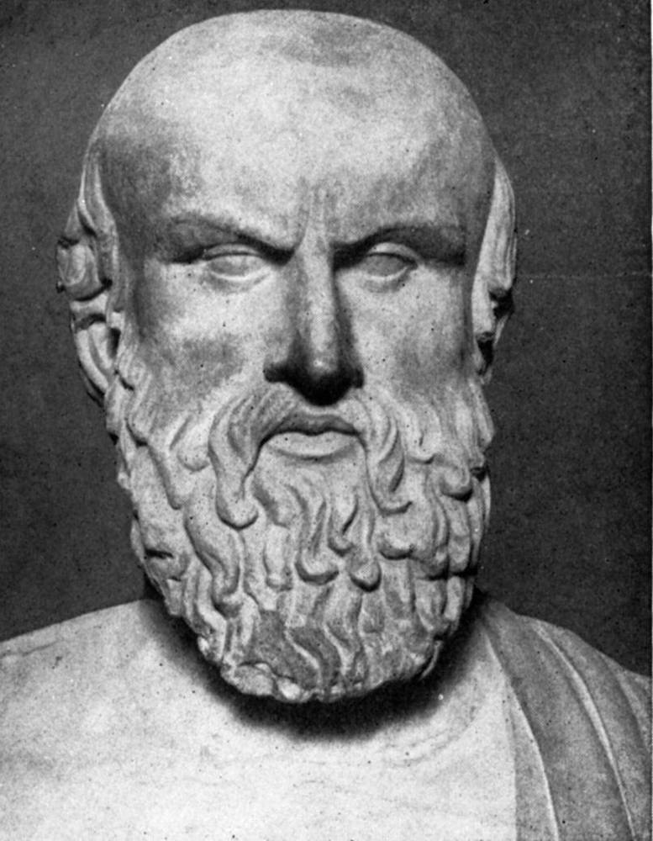
Aeschylus (523-456 B.C.E.)
“The Father for Tragedy”
Oldest plays surviving
7 of 80 plays remaining
Only surviving trilogy Orestia (Agamemmnon, Libation Bearers, Eumenides)
Winner of the Festival of Dionysus 13 times
Contributions
First to add a second actor to allow for dialogue
First to allow chorus to be part of the action

Slide 9
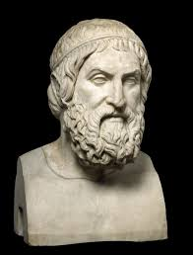
Sophocles (496-406 B.C.E.)
Considered “best of the three”
Won 24 contests at festival
7 of 120 plays survived
Oedipus the King “perfect Greek tragedy”
Contributions
Addition of a 3rd actor
Limit chorus to 15 actors
First use of scene painting

Slide 10
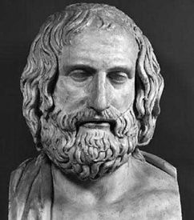
Euripides (480-406 B.C.E.)
Won festival only 4 times
18 plays survived
Most unique of the three
Mainly minor myths or greatly changed major myths
Contributions
First to combine tragedy and comedy elements
Only surviving satyr play Cyclops

Slide 11
http://www.brighthubeducation.com/homework-help-literature/64195-festival-of-dionysus/
http://www.brighthubeducation.com/homework-help-literature/64434-major-greek-playwrights-aeschylus-sophocles-euripides/?cid=parsely_rec
http://www2.cnr.edu/home/bmcmanus/tragedy_theater.html
http://english.tjc.edu/engl2332nbyr/Greektheaters.htm

