Slide 1
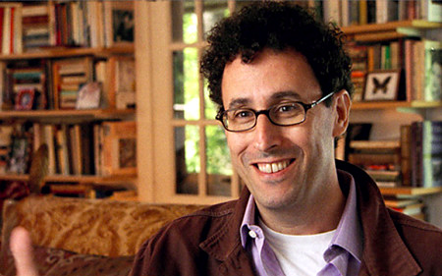
Tony Kushner
By: Ms. Taylor

Slide 2
All About Tony
Tony Kushner was born in Manhattan, NY, but soon moved with his family to Louisiana where he grew up.
He moved back to New York to attend college at both Columbia, and NYU
He received a National Medal of Arts from President Barack Obama in 2013
He co-wrote the screenplay to the film Munich which was nominated for best screenplay, director, picture, original score, and editing.
He wrote the screenplay to the film Lincoln, which was nominated for 12 Academy Awards. Daniel Day-Lewis won both the Oscar and Golden Globe for best actor.

Slide 3
Personal Life
Kushner is Jewish, and married his longtime partner Mark Harris in 2008.
Both of these personal items have greatly influenced his work. It has also influenced his political work regarding Israel’s treatment to Palestinians.

Slide 4
Angels in America
Angels in America is undoubtedly Kushner’s most famous, and most influential work.
It’s technically a play in two parts and the full title is Angels in America: A Gay Fantasia on National Themes
The first part of the play is called Millenium Approaches, and the second part is called Perestroika
Millennium Approaches won the Pulitzer Prize in 1993, and the Tony award for best play in the same year. In 1994 Perestroika won the Tony for best play.
It was famously turned into an HBO miniseries (for which he wrote the screenplay) where it won 11 Emmys and 5 Golden Globe awards. It is also an opera.

Slide 5
Significance/Context of Angels in America
Tony Kushner is a contemporary playwright, thus his play is usually classified as contemporary work.
His play can also be studied under the lense of Queer Theory, or LGBTQ studies.
It’s a 7 hour play (when performed in both parts) and takes place during the Reagan era AIDS epidemic in New York
It was the first major play (with worldwide fame/success) that deeply studied religion/AIDS/politics in contemporary American society. The famous musical Rent dealing with similar themes debuted in 1994 and gained similar notoriety.

Slide 6
Religious Content in AIA
Not only does this play deal with LGBTQ issues and the AIDS epidemic, but it also is deeply religious
There are many Biblical references throughout the show, as well as Jewish and Mormon main characters.
The play also focuses on the complexities of one of the characters who is married, Mormon, and gay. Can he be all of these things? What are the differences of being Christain and gay, and being Jewish and gay?
Millenium Approaches ends with the angel crashing through Prior’s ceiling as he ponders his relationship with God, life, AIDS, and being gay.

Slide 7
Very Controversial
Despite religion the play is very famous for its blunt political portrayals, heavy obscenities, and portrayal of sex and homosexuality.
Many say this was the first play ever to treat issues like these with such reality and candor. Kushner censors nothing.

Slide 8
On Why the Play Is Set in NY
“Who is it, Baudrillard? One of those French guys said New York is the city of the Apocalypse. It has a kind of real and unreal feeling. It’s also a city of towers, it points upward, so obviously it has this feeling of vision, of a hallucination almost.”
-Tony Kushner

Slide 9
Influence
This play has affected both theatre and film in a huge way. Its look at LGBTQ issues has changed the way people see and understand AIDS/religion/homosexuality in America.

