Slide 1
Ancient Greece
508-322 BC
Notes:
Classical Period OR Hellenic Period followed the Achaic Period

Slide 2
Historiography
First period to have proper history recordings.
Biased because main historians were from Athens or supported Athens.
Herodutus
Thucydides
Xenophon
Plato
Aristotle

Slide 3
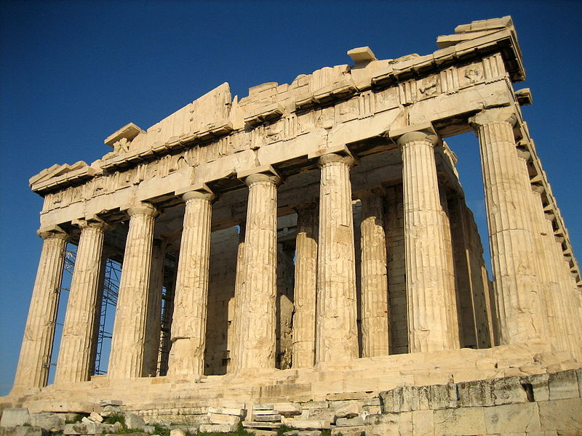
Parthenon- temple dedicated to Athena and has become a symbol for Greece, specifically Classical Greece

Slide 4
Politics
Politically, the Classical Period was dominated by Athens and the Delian League during the 5th century, but displaced by Spartan hegemony during the early 4th century BC, before power shifted to Thebes and the Boeotian League and finally to the League of Corinth led by Macedon.

Slide 5
Peloponnesian War 431 B.C. – 404 B.C.
War against Athens and its allies (Delian League) and Peloponnesian League (led by Sparta).
At the End Sparta became master of Greece.

Slide 7
Alexander the Great
Ruled Greece at the end of the classical period.
His death marks the end of the period.
Said to be one of the most successful political leaders of all times.

Slide 8
Athens
Center of the Arts, Learning, and Philosophy
Plato
Aristotle
Socrates
Sophocles
Aeschylus
Euripides
“Cradle” of Western Civilization and Birthplace of Democracy

Slide 9
Gods
Primarily in human terms.
Relied a lot of man because Gods were unpredictable and fickle.

Slide 10
Legacy
Will Durant - "excepting machinery, there is hardly anything secular in our culture that does not come from Greece," and conversely "there is nothing in Greek civilization that doesn't illuminate our own".
Noted commentator Marianna de Marzi has also observed the extent to which Classical Greek thought has influenced the progression of Western civilization, writing: "The profundity of the knowledge gained through this period in history; in art, mathematics, music and more, is incomparable to almost any other chapter in human inquiry."

Slide 11
https://education-portal.com/academy/lesson/greek-theatre-tragedy-and-comedy.html#lesson

